Slide 1
Introduction to the dimensions of digitalisation
Module 4.1:
Business Models
Notes:
Overall learning objective module 4: Participants are aware of specific opportunities and challenges the digital economy brings for businesses on the macro and micro level

Slide 2
Agenda
4.1 Business Models
Introduction
  Digital business vs. Non-digital
  Outsourcing
  Future of Work: Informal vs. Formal
  Challenges for developing countries
Deep Dive: Platform Economy
Notes:
Key message module 4.1: The business is the provision of services to people and entities. For this it is required to have certain requirements.

Slide 3



Digital Business Models
Discussion
What is a digital Business Model?
Which digital and non- digital models (providing similar services) are you aware of (in developing countries)?
10 min
Notes:
Procedure:
Trainer asks participants to shortly consider the specifications of DIGITAL business models against such models without digital elements
Ask participants about their ideas
Note key points at a pinboard
Complete based on the information given on the following slide
Timing
- Please keep short (10min) as a bigger group work element follows

Slide 4
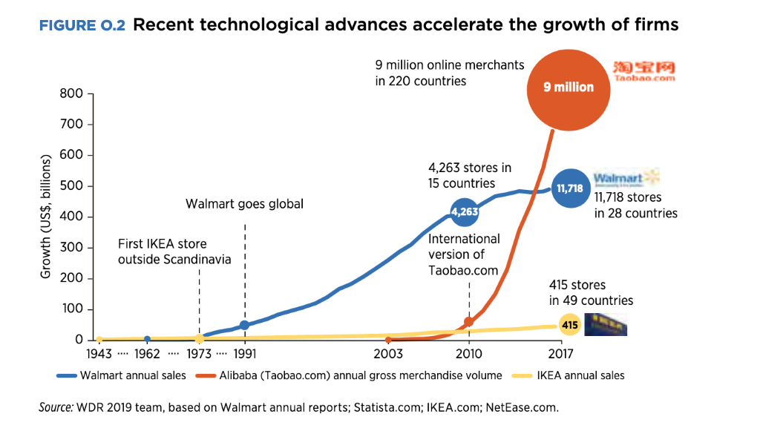
Digital Business Models bear significant economic potentials
Digital business models allow greater distribution and are able to grow fast
In only 14 years Alibaba was able to accumulate more than 9 million online merchants and annual sales of $700 billion.
Traditional models like that of Walmart or Ikea are much slower and less flexible
First platform based ventures gain significant traction in Africa as well.
Big and small examples:
Jumia: eCommerce platform focusing on African goods. Founded only 2012 it partners w/ 81,000 local African com-panies today, valued $2 bn
Farmerline (Ghana): a platform providing information on weather and market prices for 200,000 farmers.
Notes:
Background:
Digital technologies allow firms to scale up or down quickly, blurring the boundaries of firms and challenging traditional production patterns. New business models—digital platform firms—are evolving from local start-ups to global behemoths, often with few employees or tangible assets.
The rise of platform marketplaces allows the effects of technology to reach more people more quickly than ever before. Individuals and firms need only a broadband connection to trade goods and services on online platforms. This “scale without mass” brings economic opportunity to mil-lions of people who do not live in industrialized countries or even industrial areas. The changing demand for skills reaches the same people. Automation raises the premium on high-order cognitive skills in advanced and emerging economies.
Using digital technology, the Chinese conglomerate Alibaba was able to reach 1 million users in two years and accumulate more than 9 million online merchants and annual sales of $700 billion in 15 years. Meanwhile, platform-based businesses are on the rise in every country—such as Flipkart in India and Jumia in Nigeria.
For instance, the Kenyan cellphone company Safaricom employs 5,400 people in its formal business in Kenya, but it has catalyzed the creation of over 130,000 mobile money outlets (which each employ one or two people) to handle the transition from cash to mobile money.
The e-commerce platform Jumia employs 3,000 people across Africa, but has signed up 100,000 commission-based affiliates who help customers make orders through the platform.
Or In Ghana, Farmerline is an online platform that communicates with a network of more than 200,000 farmers in their native languages via mobile phone. It provides information on the weather and market prices, while collecting data for buyers, governments, and development partners. The company is expanding to include credit services.
Globally, however, integrated virtual market-places are posing new policy challenges in the fields of privacy, competition, and taxation
Resources:
WDR 2019
http://documents.worldbank.org/curated/en/816281518818814423/pdf/2019-WDR-Report.pdf

Slide 5
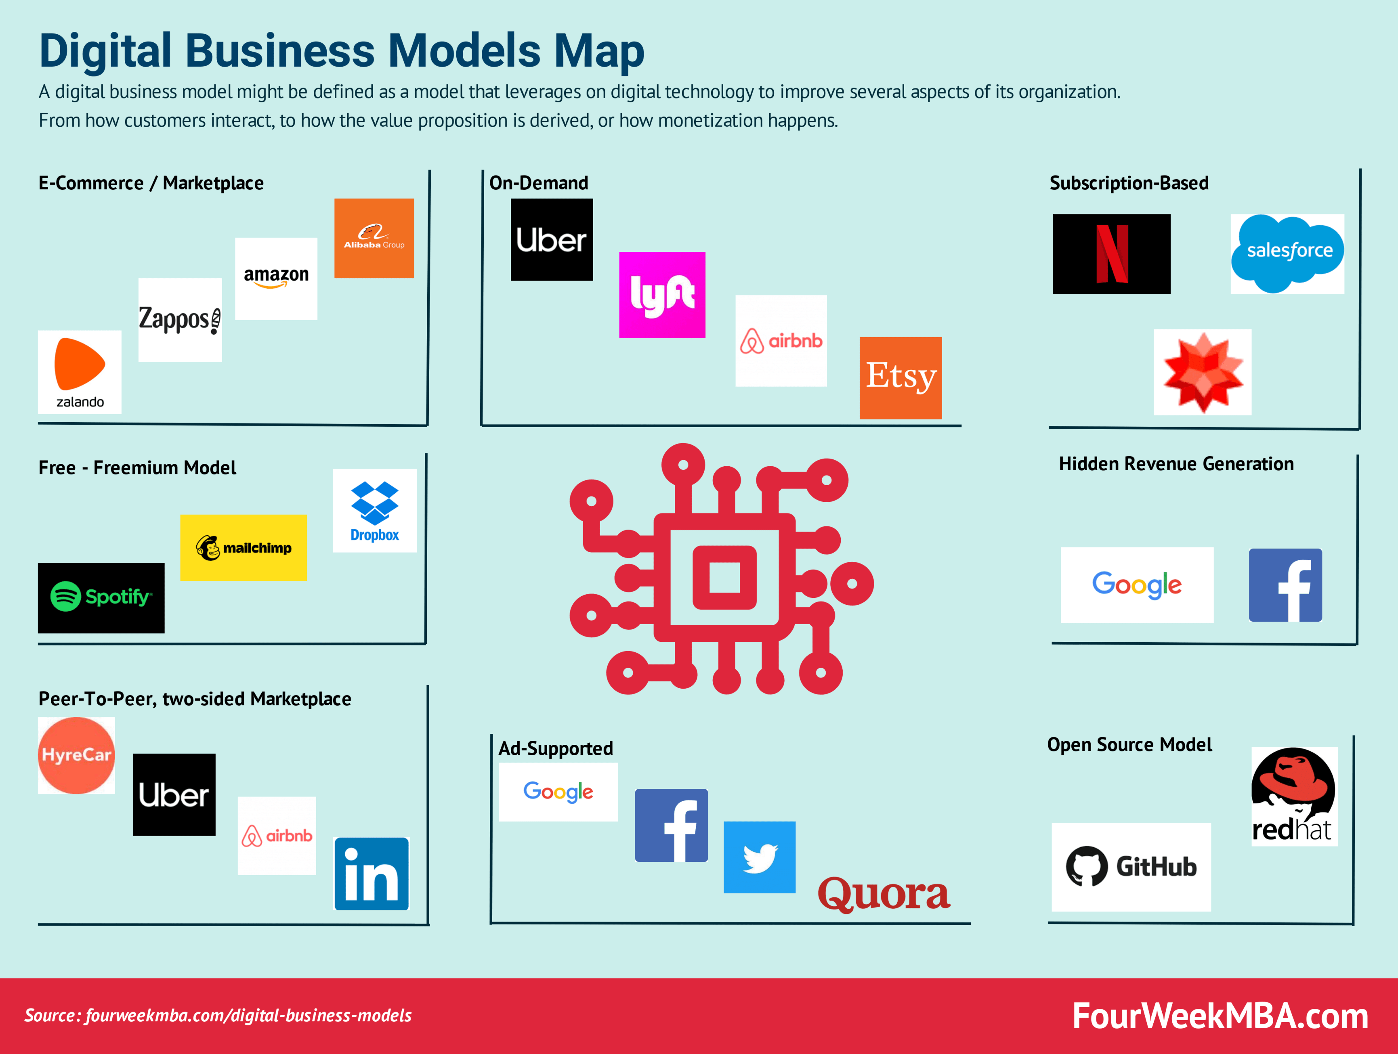
Digital Business Models
Introduction
Digital Businesses change the way we consume, live and work.
New revenue models have been created. But all elements of businesses see significant changes due to the new possibilities, digitalisation brings.

Slide 6
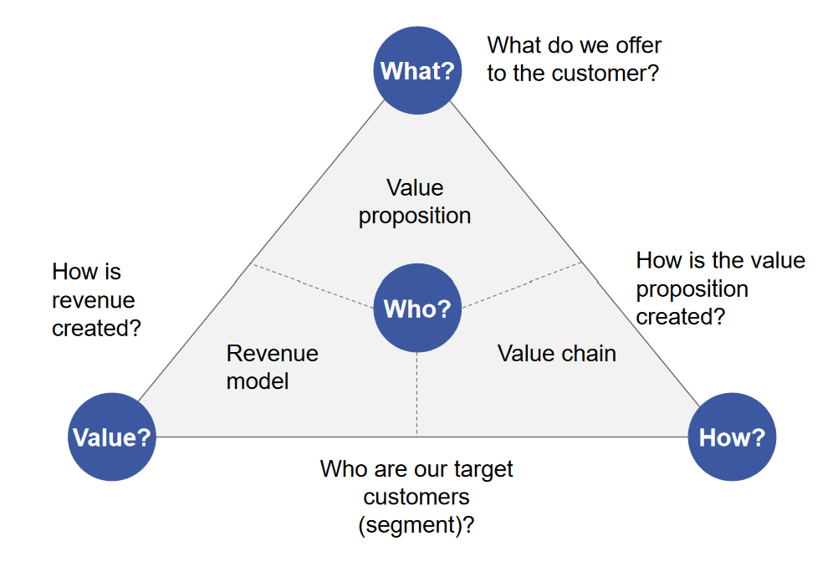
Digital Business Models
Digital vs. Non-digital
Who are our customers?
What is the value seeked in Development Cooperation?
20 min
Notes:
Procedure:
Please describe the dimensions (Background Information below) and the difference digitalisation makes here
Use examples (from DevCo)
Quickly discuss
Who is our customer (People, Governments)?
What is value from our point of view (money – to allow the sustainable operation of services; social development; …)?
Timing:
20min
Business model component –“Customers” (who?)
Customers are the focal point of business models, who can now – thanks e.g. to data and direct exchanges – can now really be put in the center of every product-development. In this context, business models also define how these customer groups should be addressed and how customer relationships should be structured. Personas are therefore created at the beginning of such processes making transparent who our target group exactly is and what it needs. Looking at your customer also think of the digital divide. How digital is the target group?
The company Mister Spex has become one of Europe’s largest online opticians by using digital technologies. Its business is based on a customer relationship in which, in contrast to “conventional opticians”, glasses are sold without personal customer contact. For example, customers can upload their image to Mister Spex’s homepage and “try on” glasses online. In order to handle services that cannot be carried out online (e.g. eye tests), however, Mister Spex cooperates with numerous local opticians.
Business model component –“Value proposition” (what?)
The “value proposition” component of the business model covers the products and services which the company offers to its customers. The use of digital technologies makes it possible to replace physical products with their intangible counterparts. An example of this is MP3 technology and the associated offering of digital music.
Mobisol – Many people lack access to electricity especially in rural areas. Solar-Home Systems are a solution. Only the investment costs are so high, that – as many again do not have access to credits - people cannot afford to buy them. Mobisol therefore rents such systems to households, until – this way – they have paid the system in full and own the devices. Digitalisation allows this. Earlier it would have been impossible to collect the monthly fees on a large scale or disconnect the systems if monthly payments are not made.
Therefore, similar to airtime, people have to pay via a mobile payment service, if the payment is not made, the solar system is automatically shut off, until the next payment is made.
Business model component –“Value chain”(how?)
The business model component “value chain” includes all activities, processes and key resources needed to render performance, i.e. to implement the business model. In order to obtain access to key resources that they do not have inhouse, companies often agree to strategic partnerships with other companies or invest in start-ups.
For enabling mobile payment Mobisol partners with mobile payment providers.
Business model component –“Revenue model” (value?)
The revenue model describes the financial aspects of the business model. It contains not only the cost structure but also the sources of income. Digital technologies can be used in particular to implement new concepts regarding sources of income.
As described, Mobisol is using a pay-per-use system. While financial sustainability is also key for products implemented by DC, this is of course not the only value of interest here. Social value and development is another. As described in Module 1, spreading knowledge, financial inclusion, providing health services, all this can be done remotely, more efficiently and effectively using digital tools. The applications are numerous!
Resources:
St. Galler Business Model Navigator (see Gassmann et al. 2013)
International Association of Controllers - Digital Business Model Innovations (2018)

Slide 7


Digital Business Models
Online Outsourcing: Inclusive jobs for everyone?
Online outsourcing or freelancing platforms match firms and workers to perform work online
Opportunities for economic advancement and income
Enhanced talent pool: from local to global scale
Inclusion potential for marginalized people, especially women
The nature of tasks favors semi-skilled and skilled workers
Automation risks
Language barriers
Weak payment systems
=> ”Analog” foundations are required for taking full advantage of online job opportunities
Notes:
Background:
Definition: Online outsourcing or freelancing platforms match firms and workers to perform work online.
Online outsourcing has two major components: “microwork,” a process in which companies contract virtual workers from around the globe to complete low-skill “microtasks” online; and “online freelancing,” where companies can hire out more complex, professional services via a virtual platform.
In response to this confluence of a need for more jobs in places where they do not currently exist, and the spreading of digital connectivity across billions of the world’s population, millions of people have turned to outsourced digitally mediated work as a way to transcend some of the constraints of their local labour markets.
Opportunities:
Opportunities for economic advancement and income
Enhanced talent pool:
Online job platforms increase the pool of talent for firms, especially for smaller enterprises and provide and opportunity to monetize skills that may not be in sufficient demand in the local economy. (example: An individual in Mongolia with expertise in web development and Python can make up to 40 US$ an hour online). On the largest platforms, most workers are located in developing countries and most employers come from developed countries.
Inclusion potential for marginalized people, especially women
Internet-enabled offshoring and outsourcing, including online work Internet-enabled offshoring is an important source of jobs in developing countries and for women. Online work can prove particularly beneficial for women, youth, older workers, and the disabled, who may prefer the flexibility of working from home or working flexible hours. On freelancer.com—an online outsourcing platform with more than 10,000 microworkers globally—57 percent of workers are between 16 and 25 years of age.47 In Elance (part of Upwork), 44 percent of workers are women, com- pared with just 25 percent in the nonagricultural economy ((Source: Digital Dividends report; world bank)
Stats:
Upwork a freelance broker reported that jobs associated with data and artificial intelligence were among the fastest growing in the fourth quarter of 2017 (Upwork 2018).
Freelancers can earn money from jobs in data-related areas on Mechanical Turk (www.mturk.com); As of May 2019, approximately 60% of workers were located in the United States and 40% are located elsewhere in the world; approximately 30% are in India
Challenges:
The nature of tasks favours semi-skilled and skilled workers
Online outsourcing is only available to those with internet access. This already limits opportunities. But with the ever increasing expansion of internet access, the greater challenge will be skills: Skills demands for online work are still high for most workers in developing countries. Tasks available today on online outsourcing platforms range from very easy tasks to complex ones. Microwork platforms offer relatively easier tasks such as image tagging, text transcription, and data entry. Online freelancing platforms post more advanced tasks like graphic design, web development, and technical report writing. Addressing this skills barrier requires additional training for potential workers to learn how to better navigate the system and learn new skills.
Automation risks
Many of the characteristics that make jobs “offshorable” also make them more vulnerable to automation. So, as technology improves and wages rise, some of the jobs typically offshored, such as call center jobs, could be automated. Indeed, a local health care company in South Africa is already using Watson, IBM’s artificial intelligence system, to assist in customer service
Example (back-up)
Some platforms, such as Samasource, have been providing such training in developing countries. Samasource provides a host of impact programs to ensure their workers are advancing in their careers and learning life skills.The potential of combining access to these platforms with online learning can be large.
Language barriers
Most of the platforms operate in English. Thus, without English skills, it is difficult to navigate the system, communicate with the clients, and perform the work.
Weak payment systems
Access to an online payment system is essential for the workers to receive compensation. Yet, in many countries, workers find weak payment systems to be a barrier. Some of the most popular forms of payment rely on online payment platforms such as PayPal, Skrill, and wire transfers. In this case, online outsourcing platforms suggest alternative mechanisms, such as Payoneer and Skrill. Payoneer transfers money to a prepaid debit card usable in shops or at ATMs to withdraw cash. This mechanism can facilitate the inclusion of disadvantaged young people and women who are disproportionately likely to lack formal bank accounts
=> ”Analog” foundations are required for taking full advantage of online job opportunities
Such das acquisition of necessary skills, policies to facilitate cross-country financial transactions and e-payment infrastructures
Sources:
World Development Report 2016 “Digital Dividends”

Slide 8

Digital Business Models
The informal sector in times of digitalisation: Example Lynk (Kenya)
GIG Economy = a labour market characterized by the prevalence of short-term contracts or freelance work as opposed to permanent jobs
Notes:
Background:
Video: Lynk transforms the informal sector in Kenya (7:36)
Source: https://www.youtube.com/watch?v=ZG7uTJh1dlM

Slide 9
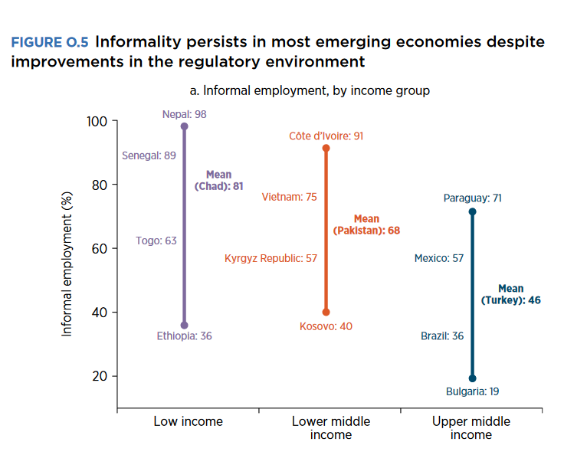
Digital Business Models
The informal sector in times of digitalisation
The informal and gig sectors hold a big share of national business and employment
Digital platforms like Lynk promise:
  Work (better access to markets)
  Trust (evaluation of workers and employer)
  Formalization (thanks to the work-data collected)
  Qualification (
  Education /Qualification (Qualifications provided based on the work conducted, additional education offered based on work and qualifications)
Notes:
Resources:
Brookings Institute
https://www.brookings.edu/blog/africa-in-focus/2019/03/20/a-gig-economy-solution-to-boost-employment-in-africa/
Gender and the GIG Economy (ODI, 2019)
https://www.odi.org/sites/odi.org.uk/files/resource-documents/12586.pdf
WDR 2019
http://documents.worldbank.org/curated/en/816281518818814423/pdf/2019-WDR-Report.pdf

Slide 10
Digital Business Models
The GIG economy blurs the line between formal and informal work
A single identity through different platforms would be an important way for workers to:
carry their reputation,
their financial history,
and potential benefits packages with them as they move from gig to gig.
Governments could offer benefits such as health insurance and pensions directly through interfaces in the platforms.
Governments could also tax gigs and the return the taxes via social benefit packages.
This would be a form of formalization
Unequal access:
excludes left-behind groups from economic opportunities
exacerbating existing inequalities in the labour market.
Moreover the gig economy could lead to more exploitation via intensification of work and overtime.
Without a consistent online identity for every worker possible social benefits cannot be effective.
This would exacerbate informality
Notes:
Background:
Formalization:
Allowing workers to maintain a single identity through the different platforms would be an important way for individuals to carry their reputation, their financial history, and their benefits packages with them as they move from gig to gig. Governments could offer benefits such as health insurance and pensions directly through interfaces in the platforms. Governments could also tax gigs and the return the taxes via social benefit packages.
This would be a form of formalization
Informal:
Unequal access to digital platforms has the potential to exclude left-behind groups from the economic opportunities those platforms facilitate, reproducing and exacerbating existing inequalities in the labour market. Without a consistent online identity for every worker possible social benefits cannot be effective.
This would exacerbate informality

Slide 11
Digital Business Models
Discussion: Informal and formal work
Is digitalisation a step towards formalising the informal sector?
Which potentials and challenges do you see?
10 min
Notes:
Procedure:
Ask participants to share their thoughts: Is digitalisation a step towards formalising the informal sector? Which potentials/challenges do they see?
Write down main results on cards and map them on a flipchart for later reference
Timing:
10min

Slide 12
Digital Business Models
Significant challenges for developing countries
Poor quality of education systems especially with regards to ICT-integration into training/curricula=> Lack of digital literate workers
Digital Divide (especially lack of infrastructure, lack of relevant advanced digital skills)
Insufficient Regulation
Lack of access to finance
Strong competition from developed countries in a world of digital services, where borders become less relevant
  Knowledge of specific needs of local population is a key opportunity and strength of local businesses
Notes:
Background:
Please be aware of difference in this context:
eLiteracy = knowledge on how to use ICTs,
advanced digital skills (eSkills) = specific ICT expertise (use of office software, programming abilities, use of statistical software tools etc.)

Slide 13

Deep Dive:
The Platform Economy

Slide 14


Platform Economy
Definitions and Options
Platform Economy
Marketplaces, accessible to everyone, collecting great amounts of data
Example: Amazon, Facebook, etc.
Sharing Economy
Platforms increase the potential to maximise the use of resources
Example: Uber, blabla car, AirBNB, Couchsurfing
?
Non commercial platforms instead of businesses
cut out the middleman with e.g. Blockchain-based platforms
  Open question:
    A strategy for DevCo?
    A good idea at all?
Notes:
Participants learn about the business models of the platform economy/sharing economy
Background:
Business models of the platform economy/sharing economy
Platforms: Compare Platforms to old Marketplaces or shops.
Here as well, traders provide products from different producers to many customers.
Just with a significantly lower reach
And fewer insights (data) gathered, which is used extensively (as an alternative source of income, marketing and the provision of better services)
Resources:
Harvard Business Review - https://hbr.org/insight-center/the-platform-economy
Issues in Science and Technology - https://issues.org/the-rise-of-the-platform-economy/
Sharing Economy:
is a mode of consumption whereby underutilized assets are shared, either for free or for a fee. It includes "sharing, bartering, lending, trading, renting, gifting, and swapping redefined through technology and peer communities. Other examples include: exchanging, collective purchasing, shared ownership, shared value, borrowing, and subscription based models.
Sharing does not always need to include payment or a service delivered! Blabla car allows joining travel that would have taken place anyways. Couchsurfing is an example for sharing without financial interest
Non-commercial platforms instead of businesses
Platforms like AirBNB, Uber etc. could work, based on Blockchain for example and the global community, without business in the background being common property. Costs for infrastructure could automatically be collected from services being provided (via smart contracts). The platform would own that money, no person and it could pay services it needs by itself.

Slide 15







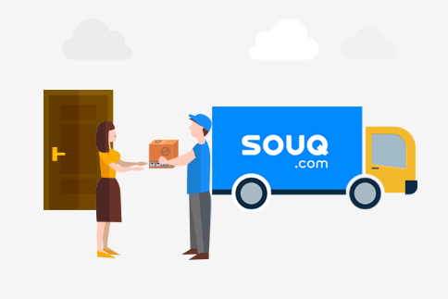
Platform Economy
The role of platforms in developing countries
Western platforms yet dominant
Increasing need for customized solutions and proximities to customers provide chances
Access to finance, and internet and skills
need to be increase, as well as proper
regulation put in place
Notes:
Background:
Local vs. Foreign Platforms
As markets become increasingly customized, multiple entry points appear both for firms and for nations, given coherent digital strategies. The Global South has some advantages to exploit, such as population size and knowledge about local market peculiarities.
The division between local and foreign platforms is becoming increasingly blurred. Many domestic platforms may be unable to compete with international platforms. In addition, once domestic e-commerce platforms achieve a certain scale, they often become targets for acquisition by global players. For example, recently, Walmart has acquired Flipkart, Alibaba has acquired Lazada and Amazon has acquired Souq. Due to the existence of network effects, local platforms may not become profitable until they reach a critical mass. If only 2–3 per cent of consumers in a country buy online, it may not be worthwhile to invest in digital platforms.
In some developing countries, the absence of global platform providers creates scope for local players. For example, in sub-Saharan Africa, various e-commerce solutions have been developed to facilitate commerce over feature phones. There are thousands of e-commerce start-ups throughout the continent, but only a few have reached significant scale. Many new e-commerce payment gateways have also cropped up. In various low-income developing economies, new e-commerce sites are targeting the domestic market, enabling consumers to browse and order goods or services online. More research is required to understand the income and employment effects of local e-commerce platforms.
Size and market penetration vs. Customization
Developing countries should focus private sector development on digitally enabled micro, small and medium enterprises. Although size and market incumbency have so far played the decisive role in determining global leadership in the data- driven economy, any country and company can find its niche.
As markets become increasingly customized, multiple entry points appear both for firms and for nations, given coherent digital strategies. The Global South has some advantages to exploit, such as population size and knowledge about local market peculiarities.
Technological leapfrogging vs. need for new concepts regarding privacy, regulation and taxing
Developing countries should aim to leapfrog traditional technologies in adopting solar-electric, internet-based urban systems.
the infrastructure deficit in developing countries can be considered a blessing as well as a curse, given that the ever-growing pace of technological development leads to faster obsolescence rates. As pointed out by Martin Mühleisen (2018), “it is striking that less- developed countries are leading technology in many areas, such as mobile payments (Kenya), digital land registration (India), and e-commerce (China). These countries facilitated the quick adoption of new technologies because, unlike many advanced economies, they weren’t bogged down in pre-existing or antiquated infrastructure.”
BUT: The current system for data protection is fragmented, and national data policy and legislation has not yet been developed in many developing countries. Policymakers in both developing and developed countries face the challenge of taxation with regard to the digital economy (regulation/taxation issues will be covered in more detail in the following session)
Resources:
http://www3.weforum.org/docs/WEF_Our_Shared_Digital_Future_Report_2018.pdf

Slide 16
Platform Economy
Discussion: A game changer for developing countries?
How can developing countries make the most of potentials of the platform economy?
How can developing countries create the right conditions to support effective, secure, and inclusive digital platforms?
10 min
Notes:
Preparation (to be prepared ahead of training):​
Prepare pens, a board and post-its in sufficient quantity for all participants
Procedure:
Trainer asks participants to collect buzzwords/ideas on post-its and present a short statement in the plenary. Post-its are collected on a board for reference. Participants exchange on their ideas on how developing countries can get their seat at the table in the digital platform economy
Timing:
Min. 10min
Background:
The expansion of digital platforms can spur economic growth through the emergence of entirely new business models, promote meaningful interaction between governments and citizens, and provide innovative solutions to complex development challenges.
For developing countries, digital platforms generate both opportunities, to engage in trade and to develop, as well as challenges.
Gains are not automatic, and there are growing concerns over the rising market power of certain platforms and the related implications for competition, data protection and ownership, consumer protection and taxation and employment policies.
How can developing countries make the most of these opportunities? And how can developing countries create the right conditions to support effective, secure, and inclusive digital platforms?
Resources:
https://unctad.org/en/PublicationsLibrary/presspb2019d2_en.pdf

