Slide 1
Introduction to the dimensions of digitalisation
Module 4.2:
Mapping the Requirements
Notes:
Overall learning objective module 4: Participants are aware of specific opportunities and challenges the digital economy brings for businesses on the macro and micro level

Slide 2
Agenda
Module 4.2: Mapping the Requirements
Pillar 1: Taxation
Pillar 2: Intellectual Property Rights (IPR)
Pillar 3: Financial Inclusion
Notes:
Key message module 4.2.: The digital transformation comes with potentials and pitfalls for taxation, IPR and financial inclusion issues

Slide 3

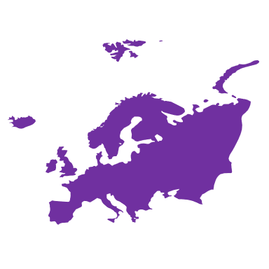





Taxation
The digital economy raises challenges for taxation
Traditional Economy
Digital Economy
Taxes based on permanent residency
Digital platforms mostly based on intangibles
weakens the international tax concept
Where to tax non-resident digital businesses?
How to assess intra-group transactions?
How to classify digital goods?
How to identify taxpayers?
Where and how to collect taxes?
Notes:
Background:
Current tax rules were designed to apply to business models with a physical presence, which usually is the basis for the governments to exercise their tax powers.
The rise of new technologies, however, has led to a change: many digital businesses have customers and generate economic value in a country without any presence in that country. This mismatch, and the fact that digital businesses derive income mostly from intangible assets, lead to the non-taxation of profits from such activities.
Taxation can provide global digital platforms a significant competitive advantage. Reliance on digital platforms, which are based mostly on intangibles may weaken the international tax concept that places jurisdictional tax claims over profits of multinational corporation based on physical presence. Traditional corporate tax systems are based on permanent residency and have not kept up with the nature of the digital economy.
This raises questions about enforcement:
Where to tax non-resident digital businesses?
How to assess intra-group transactions?
How to classify digital goods?
How to identify taxpayers?
Where and how to collect taxes?
There is growing interest among policymakers in the implications of data-driven development for taxation policies. More than 110 countries and jurisdictions have agreed to review key concepts of the international income tax system, responding to a mandate from the Group of 20 finance ministers to work on the implications of digitalization for taxation.
Source: UNCTAC, 2019, The value and role of data in electronic commerce and the digital economy and its implications for inclusive trade and development
https://unctad.org/meetings/en/SessionalDocuments/tdb_ede3d2_en.pdf

Slide 4

Taxation
The digital economy raises challenges for taxation
Global digital platform companies engage in
Developing countries do have low tax rates
But lack digital infrastructure (including legislation and trust) to attract big digital firms
While these markets become more and more important
Taxes are payed somewhere else
tax optimization practices,
shifting of profits towards locations with lower taxation rates,
which leads to erosion of the tax base.
Global South
Notes:
Background:
Moreover, the digital economy may enable global digital platform companies to engage in tax optimization practices, through shifting of profits towards locations with lower taxation rates, which leads to erosion of the tax base. While this is a concern for all countries, it may have significant implications for the availability of domestic resources for development in developing countries
Visicios circle: Development Countries do have attractive tax rates → but they do lack the appropiate infrastructure (including legislation, trust etc.) → do not benefit from digital economy.
Could be a leverage point for development cooperation: Supporting an appropriate infrastructure could attract global digital platform companies which in turn will have positive effects on other sectors inlcuding human development, local economies and education for example to train skilled personnel → in sum reverse the vicious circle.

Slide 5
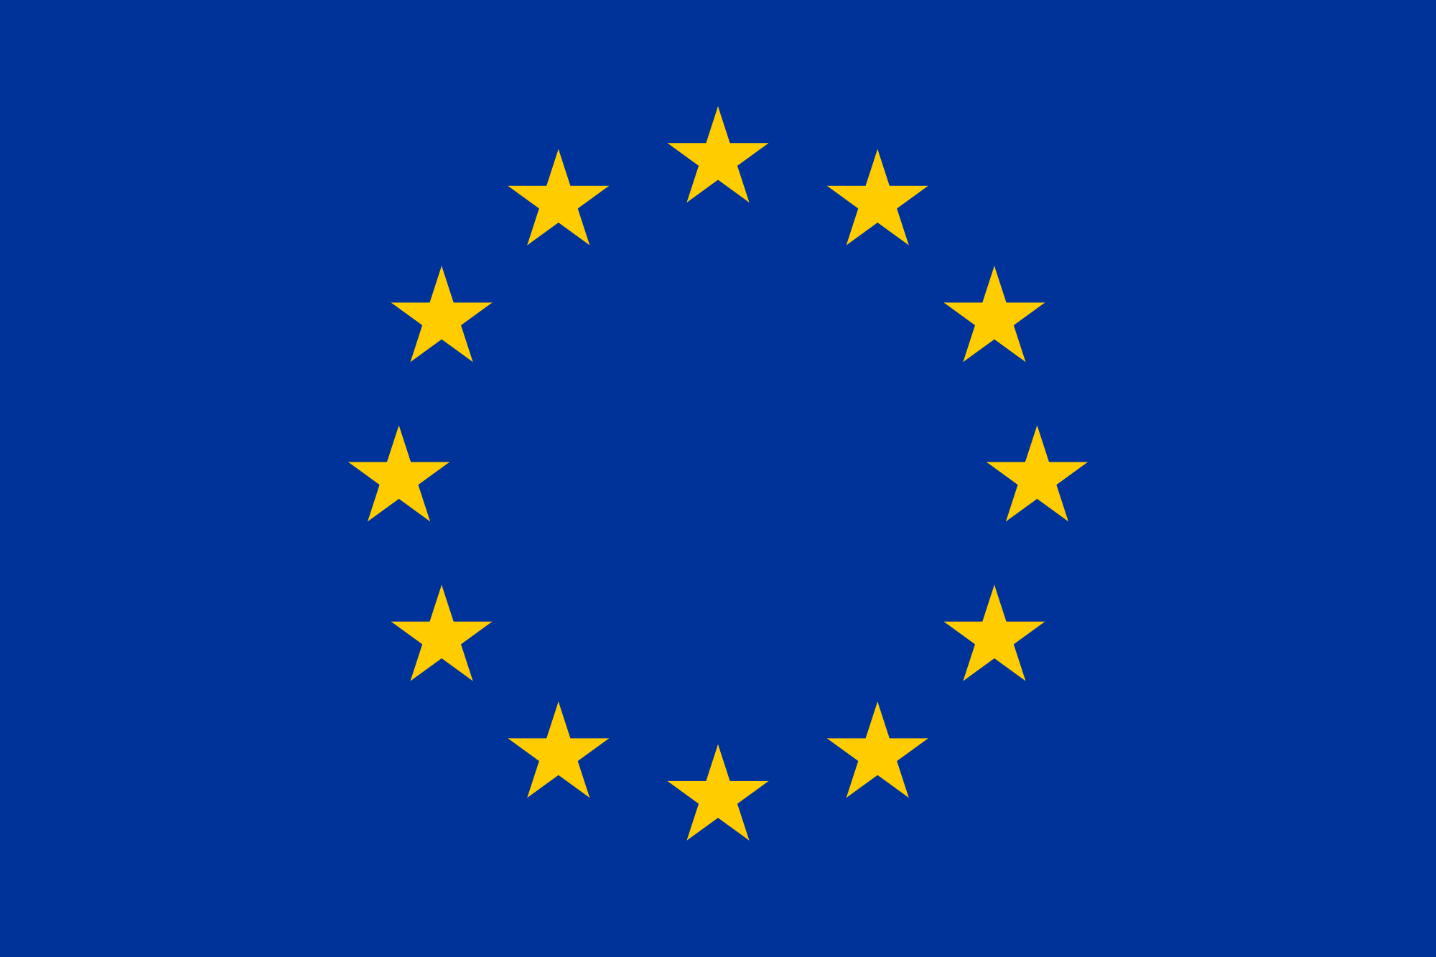
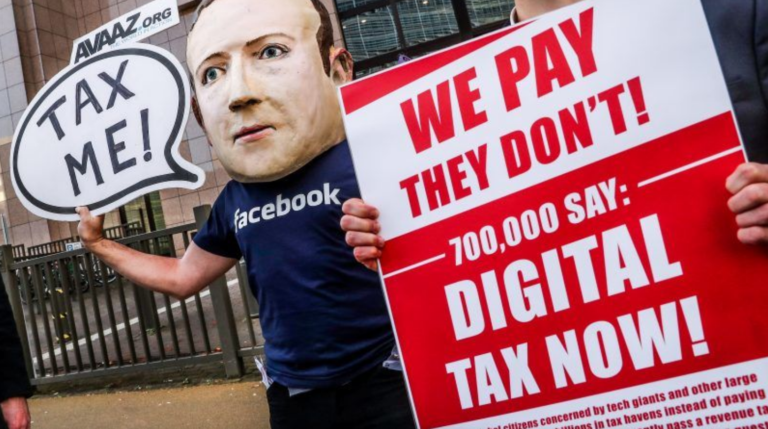
Taxation
Approaches for taxing digital businesses Example: European Union
Notes:
Trainer choses examples according to participants interests:
EU
OECD
Malaysia
Benin
EU example:
In March 2018, the European Commission adopted two legislative proposals to adapt existing tax rules to the digital economy.
The first initiative (proposal for a Council Directive laying down rules relating to the corporate taxation of a significant digital presence ) aims to reform corporate tax rules so that profits are registered and taxed where businesses have significant interaction with users through digital channels. The Commission suggests this as long-term solution.
The second act (proposal for a Council Directive on the common system of revenues resulting from the provision of certain digital services ("digital services tax"), would result in an interim tax which member states would have to implement and apply, covering certain digital activities that generate revenues in the EU
Status Quo (as of May 2019)
Council cannot reach an agreement on EU digital services tax
The Council took note of the progress achieved in the negotiations on the digital services tax, since the issue was last discussed at the Council meeting in December 2018, on the basis of a new compromise text setting out a scope limited to digital advertising services.
The discussion revealed that despite the broad support from a large number of member states on this text, some delegations maintain reservations either on some specific aspects of the proposal or more fundamental objections.
In parallel, the Council presidency will conduct work on the EU position in international discussions on digital tax, in particular in view of OECD's report on the issue, due by mid-2020.
Additional information
Despite the strong support by the European Commission and the European Parliament, the decision of around half of the member states to introduce a similar levy and the Franco-German’s last-ditch effort to reach an agreement by limiting the scope of the tax, Ireland, Sweden and Denmark still reject the European solution.
The reasons vary. But the three of them consider that it is time to move on and focus on the efforts at an international level led by the Organisation for Economic Co-operation and Development (OECD).
The Commission proposed last March to apply a 3% rate to online advertising, digital intermediary activities, including social platforms or e-commerce; and the sale of data.
It was expected to collect around €5 billion per year
Resources:
https://www.euractiv.com/section/economy-jobs/news/the-eus-digital-tax-is-dead-long-live-the-oecds-plans/
https://www.consilium.europa.eu/en/policies/digital-taxation/

Slide 6

Taxation
Approaches for taxing digital businesses Example: OECD Inclusive Framework on BEPS
Background:
  Framework is developed in order to tackle domestic tax base erosion and profit shifting (BEPS) due to multinational enterprises exploiting gaps and mismatches between different countries’ tax systems affects all countries. (Developing countries’ higher reliance on corporate income tax means they suffer from BEPS disproportionately.)
  As businesses act globally, governments have to agree on a global approach. In the this Project, over 60 countries cooperate to tackle tax avoidance, improve the coherence of international tax rules and ensure a more transparent tax environment
Tax and Digitalisation
  According to the project digitalisation presents no unique BEPS issues
  But introduces some challanges that go beyond BEPS, notably in relation to „nexus, data and characterization“
  Also there is a wide range of implications as it offers potentials and introduces new challenges
  Potentials: More tax-income thanks to better economy, more data on taxation and e.g. the transition of informal to formal work thanks to online platforms (see GIG-Example)
  Challenges: the high importance of intangible assets in digital businesses as profit drivers makes these ideally placed to shift income to low tax countries
  New intangible values as bitcoins are difficult to track and to tax
Notes:
Background:
Discussions are currently also ongoing at international level to find a consensus-based long-term global solution. The OECD has taken up work on this issue and has published an interim report in March 2018. Its "Task Force on digital economy" aims at producing a final report to the G20 by 2020.
Current status (as of May 2019)
The international community has agreed on a road map for resolving the tax challenges arising from the digitalisation of the economy, and committed to continue working toward a consensus-based long-term solution by the end of 2020.
The 129 members of the OECD/G20 Inclusive Framework on Base Erosion and Profit Shifting (BEPS) adopted a Programme of Work laying out a process for reaching a new global agreement for taxing multinational enterprises.
The document, which calls for intensifying international discussions around two main pillars, was approved during the May 28-29 plenary meeting of the Inclusive Framework, which brought together 289 delegates from 99 member countries and jurisdictions and 10 observer Organisations. It will be presented by OECD Secretary-General Angel Gurría to G20 Finance Ministers for endorsement during their 8-9 June ministerial meeting in Fukuoka, Japan.
Drawing on analysis from a Policy Note published in January 2019 and informed by a public consultation held in March 2019, the Programme of Work will explore the technical issues to be resolved through the two main pillars. The first pillar will explore potential solutions for determining where tax should be paid and on what basis ("nexus"), as well as what portion of profits could or should be taxed in the jurisdictions where clients or users are located ("profit allocation").
The second pillar will explore the design of a system to ensure that multinational enterprises – in the digital economy and beyond – pay a minimum level of tax. This pillar would provide countries with a new tool to protect their tax base from profit shifting to low/no-tax jurisdictions, and is intended to address remaining issues identified by the OECD/G20 BEPS initiative.
Sources:
https://www.oecd.org/tax/beps/international-community-agrees-on-a-road-map-for-resolving-the-tax-challenges-arising-from-digitalisation-of-the-economy.htm
https://www.oecd.org/going-digital/tax-and-digitalisation.pdf
https://www.oecd.org/tax/beps/public-consultation-document-addressing-the-tax-challenges-of-the-digitalisation-of-the-economy.pdf

Slide 7
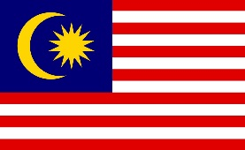
Taxation
Approaches for taxing digital businesses Example: Malaysia
In a recent study on Malaysia, the World Bank identified four ways to improve taxation of digital goods and services provided by non-resident companies:
  1. Tax digital transactions indirectly, by
  requiring suppliers to collect goods and services tax/sales and services tax in line with international practice.
  2. Tax digital transactions directly, by
  redefining permanent establishment rules,
  expanding existing tax on technical services
  establishing a new, freestanding tax on the income from digital transactions.
  All options were considered to have advantages and disadvantages
Notes:
Background:
In a recent study on Malaysia, the World Bank identified four ways to improve taxation of digital goods and services provided by non-resident companies:
tax digital transactions indirectly, by requiring suppliers to collect goods and services tax/sales and services tax in line with international practice.
Or tax them directly, by
redefining permanent establishment rules,
expanding existing tax on technical services
establishing a new, freestanding tax on the income from digital transactions.
All options were considered to have advantages and disadvantages.
Sources:
Worldbank, 2018, Taxing the digital economy in Malaysia: How do we balance growth with sustainability?
https://blogs.worldbank.org/eastasiapacific/taxing-digital-economy-malaysia-how-do-we-balance-growth-sustainability
UNCTAC, 2019, The value and role of data in electronic commerce and the digital economy and its implications for inclusive trade and development
https://unctad.org/meetings/en/SessionalDocuments/tdb_ede3d2_en.pdf

Slide 8

Taxation
Approaches for taxing digital businesses Example: Benin
Trend in Africa: Consumer related taxes
Government Benin proposed a tax on over-the-top-services (OTT):
5% tax on the pre-tax price for voice, SMS and internet services
5 CFA fee per MB for data used to access social media and OTTs
Benin reversed the policy quickly after protests.
A research by A4AI also revealed the possible negative impact of suchs models. The initiative calls for more holistic assessment of the impacts of taxes, particularly how they may decrease internet use and have negative spillover effects for the economy as a whole.
Notes:
Background:
In September 2018, the Benin government proposed a tax on over-the-top services. The proposed tax was two-fold: a 5% tax on the pre-tax price for voice, SMS and internet services and a 5 CFA fee per MB for data used to access social media and OTTs.
This move was the latest case in a recent trend among governments to impose consumer-related taxes on internet access with the goal of raising revenues and in some cases stifling free speech.
Example from Uganda showed that a social media tax (a daily fee to use over-the-top (OTT) services such as Facebook, WhatsApp, Twitter, and Viber) increased costs by as much as 10% for low-income groups. Additional research suggested the tax led to a decrease in the number of people using the internet.
Taxes like these compound the existing affordability challenge, which is one of the key obstacles to internet access around the world and particularly in Africa.
Although the Benin government quickly reversed the tax, A4AI analysed the rationale behind the original tax plan and the impacts it would have had were it implemented.
Key findings:
Large-scale online protests against the tax were one of the key factors for the government’s reversal.The Twitter campaign #TaxePasMesMo reached over 2.2 million people and news of the tax was widespread in Africa and reached as far as Mexico. These protests helped influence the government’s decision to not implement the tax. This process happened quickly — there were only 5 days between the tax announcement and its withdrawal.
Mobile internet was expensive in Benin before the proposed taxes were implemented. The price of a 1GB data plan relative to average monthly income is 7.8%, well above the 2 % affordability threshold, putting Benin 27 out of the 49 African countries we survey. Raising costs through a direct consumer tax would exacerbate this situation.
The study estimates that the taxes would have decreased the number of active mobile broadband subscribers by 20%. This would have resulted in an estimated USD 40 million in lost taxation and other revenues across the economy.
The report challenges the notion that OTTs have led to a decline in revenues in the sector. During the period 2016 to 2018, network traffic and mobile internet subscribers increased while prices declined. This suggests it is more likely that regulatory intervention in the market caused a decline in revenue, particularly as three licensees exited the market during 2017.
These findings point to a need for a more holistic assessment of the impacts of taxes, particularly how they may decrease internet use and have negative spillover effects for the economy as a whole. The report recommends that governments conduct detailed tax impact assessments prior to the implementation of taxes. Any interventions in the ICT sector should be designed to support economic growth and social inclusion.
Source:
https://a4ai.org/research/the-impact-of-taxation-on-internet-affordability-the-case-of-benin/

Slide 9
Taxation
Wrap Up
The taxation debate for the digital economy faces major challenges:
  business can be virtually conducted without any physical presence
  reliance on intangibles increases the ability of companies to structure themselves to minimise their tax liabilities
  New delivery channels and business models are hardly matched by existing rules
The international community has agreed on a road map for resolving the tax challenges arising from the digitalisation of the economy, and committed to continue working toward a consensus-based long-term solution by the end of 2020.
The imperative of technological neutrality in applying taxes should guide further discussions.
Notes:
Background:
The OECD identified three main challenges – scale without mass, reliance on intangibles and user participation. First, the fact that a business can be virtually conducted without any physical presence poses one of the main policy challenges. It is more and more difficult to determine the jurisdiction eligible for taxation under the existing rules, as assets and activities of digital businesses can easily move across jurisdictions to avoid taxable presence in a high-tax jurisdiction.
New delivery channels and new business models, such as service-oriented models using software or hardware38, cloud computing, 3D printing39, collaborative platforms and Blockchain, pose legal uncertainty for both taxpayers and administrations, as they are hardly matched by existing rules. The sheer diversity of the digital businesses and digital businesses using multiple business lines are further tax challenges, which shall be addressed by robust measures that would last in face of rapid digital evolution
There should be no specific taxation on the digital economy. It should be taxed as any other activity in order not to diminish the free flows in commerce. Harmonized nexus and profit allocation concepts should be applied, in line with the exigencies of digitalization. Ultimately, as more and more economic activity shifts online, the imperative of technological neutrality in applying taxes will become more and more important.
Source:
https://t20japan.org/wp-content/uploads/2019/03/t20-japan-tf8-4-digital-economy-economic-development.pdf
http://europa.eu/rapid/press-release_MEMO-18-2141_en.htm
http://www.europarl.europa.eu/cmsdata/161104/ST%20Impact%20of%20Digitalisation%20publication.pdf

Slide 10



Intellectual Property Rights
Discussion: EU Copyright Directive
15 min
PROS
CONS
Overdue adaption of copyright legislation to the requirements of the digital economy
Stronger position for rightsholders when negotiating with platforms
Stimulation of quality content and fair remuneration
More security for authors and performers (dispute resolution, remuneration, contracts)
Potential growth limitations for user-generated business models
Measures could restrict freedom of expression and reduce access to knowledge in the online sphere
Upload filters and global licensing involve considerable costs and practical application problems
1) What do you think about the EU Copyright Directive?
2) Where do you see the relevance for developing countries?
Notes:
Procedure:
Trainer asks participants to discuss the following questions:
Questions for discussion:
1) What do you think about the EU Copyright Directive?
2) Where do you see the relevance for developing countries?
Timing:
15min
Background Information:
The European legislative landscape is now in a heated debate about the new Copyright Directive, a directive that seeks to regulate the creators’ copyright remuneration for their online content. Simply put, it refers to situations when journalists, musicians, actors etc. creates content that is published in the online environment, content that is then retrieved and published by different people on various platforms and publications. At this time, this content can be freely retrieved without the obligation to pay its author for redistribution. The Directive aims to force large online platforms (such as Youtube or Google News) to pay royalties to news publishers and content creators for their content shared on their platforms, considering that those who share that content are platforms users and not the platforms themselves.
The new regulation encountered strong opposition from platform users and platforms owners, who believe that this will lead to restrictions regarding freedom of expression in the online environment and right to information because, in order to avoid paying such remuneration, those platforms will stop the sharing of such content.
The online complaints about the Copyright Directive are particularly focused on Articles 11 and 13.
Article 11 regulates the so-called “link tax”. Thus, reproduction that contains more than one word or very short news extracts will require licensing.
Article 13 discussions specifically focus on the so called Upload filters which are to be used by online platforms such as YouTube and Facebook in order to check whether the content users publish on their site (such as videos, images, audio files or code) are protected by copyright. During the upload user-generated content will now be matched against a database of copyrighted content. If they match or are very similar, the works will be blocked by the filter.
The rules will oblige online companies such as Alphabet Inc's Google and Facebook Inc to pay publishers for displaying news snippets and share revenue with the creative industries and remove copyright-protected content on YouTube or Instagram. They will have to sign licensing agreements with rights holders such as musicians, performers, authors, news publishers and journalists to use their work online. Exemptions are in place for companies:
that are less than three years old;
with an annual turnover below €10 million ($11.3 million);
with fewer than five million monthly users.
Non-profits and encyclopaedias such as Wikipedia will still be able to use data for research and educational purposes without being subject to the new copyright rules.
Both upload filters and global licensing involve considerable costs and practical application problems. It is known that where filters were implemented, they did not work properly, often censoring legal content, for example when YouTube filters ranked a 12-second record of a cat that was purring as copyrighted content of EMI Music. More details and cases of poor filtering can be found here (https://juliareda.eu/2017/09/when-filters-fail/).
The critics opinion is that the Copyright Directive may threaten the future of the Internet by turning it into a tool for monitoring and controlling users by using content filters and limiting the freedom of expression and the access to information by introducing the link tax.
In the context of these heated debates, the European Parliament issued a press release on its website https://www.europarl.europa.eu/news/en/press-room/20190111IPR23225/q-and-a-on-the-draft -digital-copyright-directive? fbclid = IwAR2ewsKPgMYlYJr0b2epKzfoRFxeeC3gJKZTfJjTqJ24Y405VqEukrJkKGE through which it tries to answer the most controversial issues related to this Directive. The press release refers to the Directive’s version negotiated on 13 February 2019.
Additional resources:
http://europeandme.eu/eu-copyright-directive-pro-con/
Video on Upload Filter: https://www.youtube.com/watch?v=hBCK5AOrSFgv (duration approx. 7min)

Slide 11

Intellectual Property Rights
Relevance
Intellectual Property Rights (IPR) in the digital age:
encourage new ideas
affect innovation performance
provide incentives for investment and for universities to transfer knowledge
impact how individuals and firms can access and exploit existing knowledge on efficient terms
→ The data-driven economy builds on the knowledge-based economy, in which the essential capital is intellectual property (IP).
Notes:
Background information:
Intellectual property rights (IPRs):
encourage new ideas
affect innovation performance
provide incentives for firms and individuals to invest in innovation and creativity and to exploit economically their creations,
and for universities to transfer knowledge
impact how individuals and firms can access and exploit existing knowledge on efficient terms.
→ As a result, intellectual property policy is a critical component of innovation policies. Data-driven economy builds on the knowledge-based economy, in which the essential capital is intellectual property (IP).
Source:
OECD, 2019, Going Digital: Shaping policies, improving lifes

Slide 12
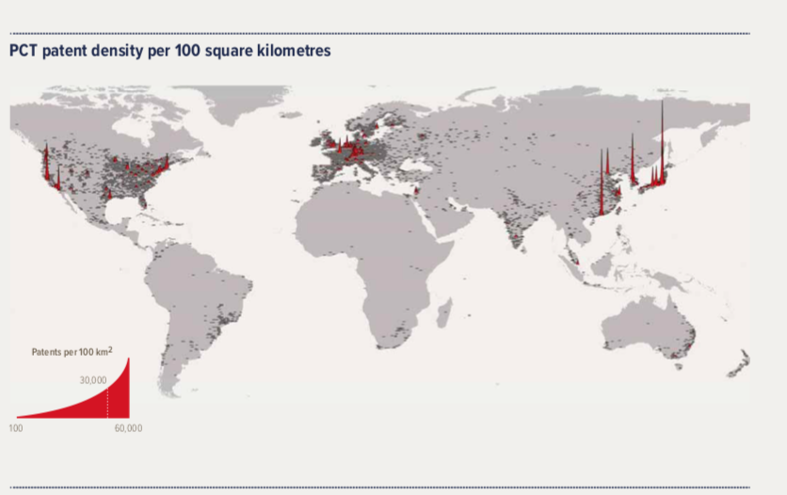
Intellectual Property Rights
Status quo in Africa
Where African economies fall short is in two predominant areas:
First, there is a lack of legal enforcement of IP rights.
Second, simply not enough people in Africa are registering their IP.
In sum, the current local systems in place to register IP are inaccessible, time consuming and difficult to use.
Patent Cooperation Treaty (PTC) is an international law treaty. Source: Table taken from the International Innovation Index 2018
Notes:
Table illustrates patent registration and exemplifies lack of registrations in Africa. Why?
Many up and coming African developers create innovative software, but they do not know how to commercialise their products. At the same time they aren’t protecting their assets, as in some cases they are completely unaware of intellectual property laws. This is mainly due to the high fees required to obtain such specialist advice.
Where African economies fall short is in two predominant areas:
First, there is a lack of legal enforcement of IP rights. This results in high online piracy rates and large amounts of counterfeit goods. Without this enforcement, entrepreneurs and developers may not feel motivated to innovate, lacking incentive to pursue creative activities that change lives and create jobs.
Second, simply not enough people in Africa are registering their IP. In South Africa, there are an average of 900 patent applications filed per month (2017). However, approximately 60 to 70 per cent of these applications originate from non-South African companies.
The current local systems in place to register IP are inaccessible, time consuming and difficult to use. This is why, in 2015, Microsoft 4Afrika partnered with the Kenya Copyright Board, to develop an online IP registration system. 4Afrika IP Hub aims to change this by giving developers the tools to monetise their apps. They also provide free online information on protecting intellectual property that developers can refer to. Finally the organisation provides platforms and access to networks to help them maximise their projects’ potential, thus helping to ensure products developed and made in Africa bring money into Africa.
The system, which allows people to register remotely, has already resulted in a 100 per cent increase in applications – and is cited by the US Chamber International IP Index as a key area of strength in Kenya’s IP climate ranking.
Further Infos: U.S. Chamber International IP Index (Feb 2019).
https://www.theglobalipcenter.com/wp-content/uploads/2019/03/023593_GIPC_IP_Index_2019_Full_04.pdf
Source table:
https://www.wipo.int/edocs/pubdocs/en/wipo_pub_gii_2018.pdf
Source text:
Disrupt Africa, 2017, Africa and IP: where do we stand?
http://disrupt-africa.com/2017/05/africa-and-intellectual-property-rights-where-do-we-stand/
And
https://atlasofthefuture.org/project/4afrika-ip-hub/

Slide 13
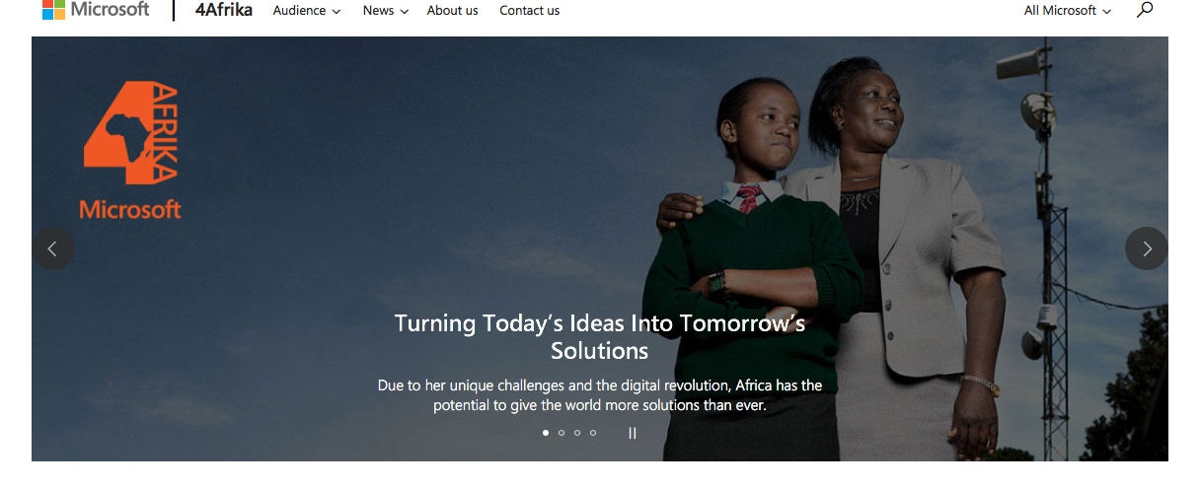
Intellectual Property Rights
Example: Microsoft4Afrika
Notes:
Background:
Challenges and opportunities when it comes to IPRs in the DC context
Possible solution:
Microsoft 4 Africa Initiative
The current local systems in place to register IP are inaccessible, time consuming and difficult to use. This is why, in 2015, Microsoft 4Afrika partnered with the Kenya Copyright Board, to develop an online IP registration system. 4Afrika IP Hub aims to change this by giving developers the tools to monetise their apps. They also provide free online information on protecting intellectual property that developers can refer to. Finally the organisation provides platforms and access to networks to help them maximise their projects’ potential, thus helping to ensure products developed and made in Africa bring money into Africa.
The system, which allows people to register remotely, has already resulted in a 100 per cent increase in applications – and is cited by the US Chamber International IP Index as a key area of strength in Kenya’s IP climate ranking.
Further Infos:
U.S. Chamber International IP Index (Feb 2019).
https://www.theglobalipcenter.com/wp-content/uploads/2019/03/023593_GIPC_IP_Index_2019_Full_04.pdf
Source table:
https://www.wipo.int/edocs/pubdocs/en/wipo_pub_gii_2018.pdf
Source text:
Disrupt Africa, 2017, Africa and IP: where do we stand?
http://disrupt-africa.com/2017/05/africa-and-intellectual-property-rights-where-do-we-stand/
And
https://atlasofthefuture.org/project/4afrika-ip-hub/

Slide 14
Intellectual Property Rights
Wrap Up
The digital transformation raises novel challenges on Intellectual Property Rights (IPR) and data: e.g. commercialisation of data, patentability of data bases and ownership of data.
The suitability of traditional measures for incentivizing the production of IP (patents and copyright) has to be discussed.
Because of different national circumstances and optimal policy choices, IPR protection is uneven across countries.
Notes:
Source:
https://t20japan.org/wp-content/uploads/2019/03/t20-japan-tf8-4-digital-economy-economic-development.pdf

Slide 15
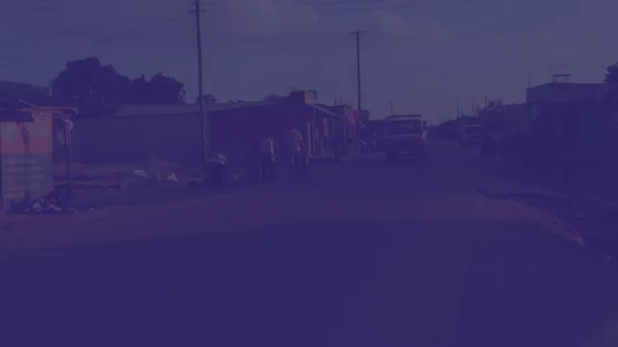
Financial Inclusion
Example: FinTech provides new options
Notes:
Video: Agence Française de Développement (duration: approx. 2min): FinTech help African entrepreneurs grow
Source:https://www.youtube.com/watch?v=TLIvZC-mqPw

Slide 16
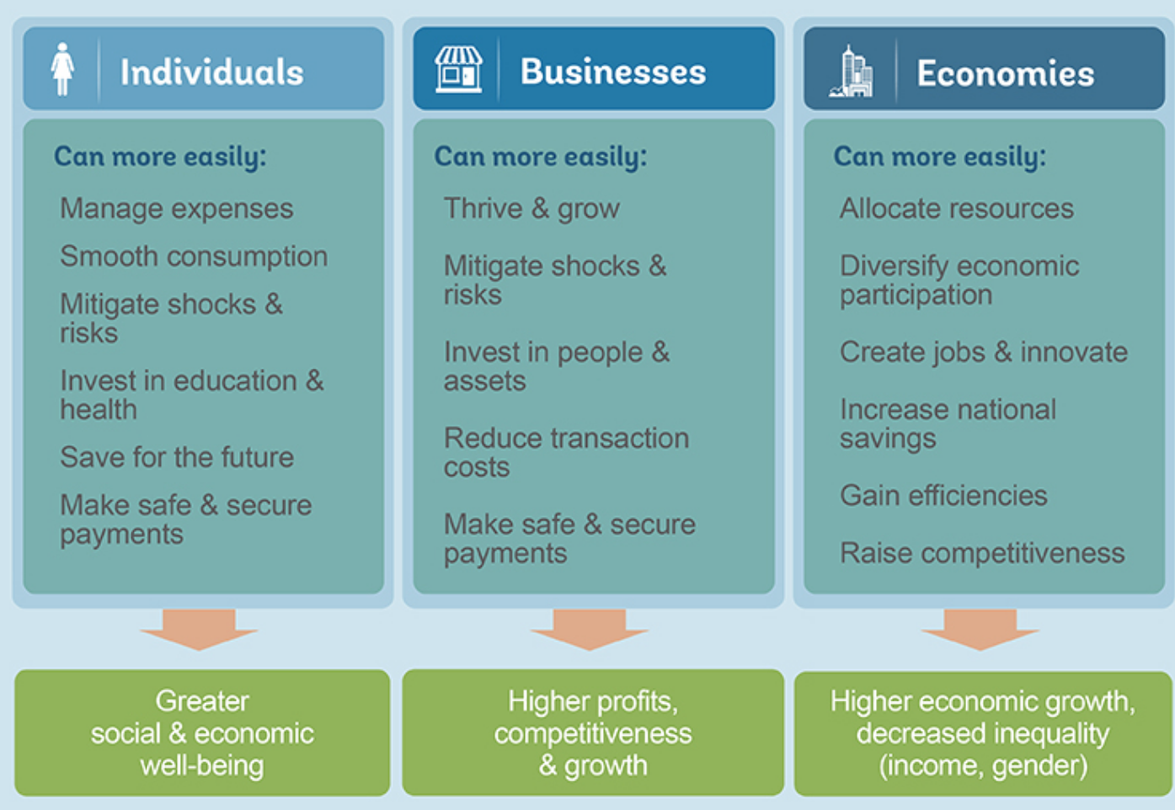
Financial inclusion
A game changer for development?
Source: Worldbank, Gateway to Financial Inclusion
Notes:
Background:
Overall financial inclusion can contribute to achieving greater social and ecnomic well-being, higher profis, competiveness and growth for businesses and decreased inequality
Financial inclusion means that individuals and businesses have access to useful and affordable financial products and services that meet their needs – transactions, payments, savings, credit and insurance – delivered in a responsible and sustainable way.
Being able to have access to a transaction account is a first step toward broader financial inclusion since a transaction account allows people to store money, and send and receive payments. A transaction account serves as a gateway to other financial services.
Advantages
Financial access facilitates day-to-day living, and helps families and businesses plan for everything from long-term goals to unexpected emergencies. As accountholders, people are more likely to use other financial services, such as credit and insurance, to start and expand businesses, invest in education or health, manage risk, and weather financial shocks, which can improve the overall quality of their lives.
Overall financial inclusion can contribute to achieving greater social and ecnomic well-being, higher profis, competiveness and growth for businesses and decreased inequality
Challenges (Backup)
Financial literacy
Products are often not designed appropriately to the needs of low-income users
The regulatory environment (especially in the African context) is often unclear
Often the regulation landscape is unclear and innovators are unaware how to develop new technologies aligned to the regulatory needs of the country. Further,this uncertainty inhibits partnerships with foreign large-scale fintech operators, as they are unclear of the medium to long-term prospects of their products in a new market.
Unfair competition practices
https://t20japan.org/wp-content/uploads/2019/03/t20-japan-tf2-10-fintech-strategies-financial-inclusion-sub-saharan-africa.pdf
Stats:
Great strides have been made toward financial inclusion and 1.2 billion adults worldwide have gotten access to an account since 2011. Today, 69% of adults have an account.
Since 2010, more than 55 countries have made commitments to financial inclusion, and more than 60 have either launched or are developing a national strategy.

Slide 17
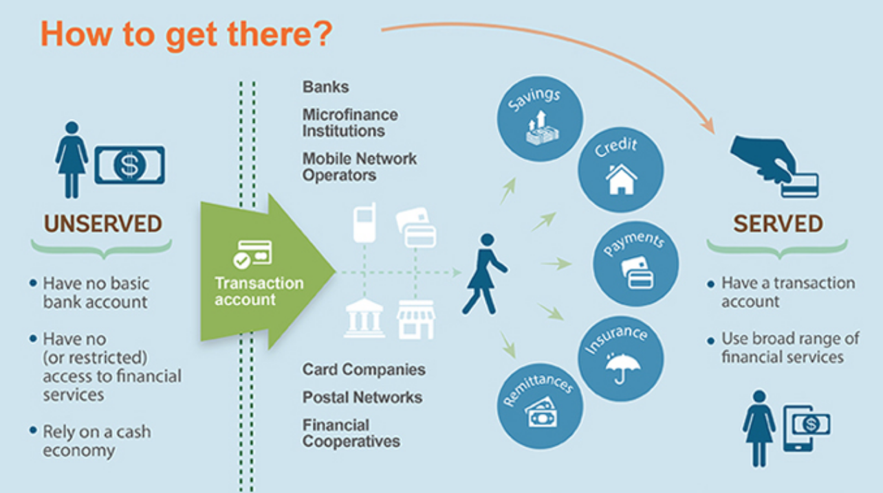
Financial Inclusion
Discussion: How do we achieve financial inclusion?
15 min
Source: Worldbank, Gateway to Financial Inclusion
Notes:
Procedure:
Trainer refers back to the examples in the video and asks participants to share their thoughts and ideas on how to achieve financial inclusion.
Timing:
15 min

Slide 18


Financial inclusion
FinTech facts and figures
1.7 billion people worldwide remain unbanked and without access to e- and m-payments
Money transfer and payments are the most commonly used financial services globally, followed by insurance
Today, approximately two-thirds of Africans remain "unbanked”. By 2022, McKinsey thinks that close to half of all Africans — about 450 million people — will be using banking services in some form
The African continent is at a leading position concerning mobile money banking
In 2017, Sub-Saharan Africa accounted for nearly a half of mobile money services worldwide
Of a total of 690 million registered mobile money accounts worldwide, 338 million users live in Sub-Saharan Africa
However, there is a significant divide in access to these services by gender and income
Notes:
Back Up
Background:
1.7 billion people worldwide remain unbanked and without access to e- and m-payments
Money transfer and payments are the most commonly used financial services globally, followed by insurance
Focus Africa:
The expansion of mobile money accounts in Africa is partly the result of the region’s poor performance in access to more traditional financial services
Today, approximately two-thirds of Africans remain "unbanked”. By 2022, McKinsey thinks that close to half of all Africans — about 450 million people — will be using banking services in some form
The Africa continent is at a leading position concerning mobile money banking
In 2017, 90 countries offered 276 live mobile money services—Sub-Saharan Africa alone accounted for nearly a half of these services (135)
Of a total of 690 million registered mobile money accounts worldwide, 338 million users live in Sub-Saharan Africa (GSMA 2017).
However, there is a significant divide in access to these services by gender and income. Although more than one in five Africans ages 15+ used mobile money services in 2017, that proportion was larger among men than women (24 and 18 percent, respectively) and among the richest 60 percent vis-à-vis the poorest 40 percent (24 and 12 percent, respectively).
The Africa region also leads the world in the percentage of the adult population sending or receiving domestic remittances through a mobile phone.
Resources:
https://www.gsmaintelligence.com/research/?file=7bf3592e6d750144e58d9dcfac6adfab&download
http://analytics.dkv.global/data/pdf/Financial-Inclusion-Developing-World.pdf
https://www.ey.com/Publication/vwLUAssets/ey-fintech-key-findings-2017/$FILE/ey-fintech-key-findings-2017.pdf
https://www.sciencedirect.com/science/article/pii/S1879933716300549
Eran Feinstein, “The Latest in African Fintech 2017 and Forecasts for 2018,” DPO Think Payments Blog, 13 December 2017.
Asli Demirgüç-Kunt, Leora Klapper, Dorothe Singer, Saniya Ansar and Jake Hess, The Global Findex Database 2017: Measuring Financial Inclusion and the Fintech Revolution (Washington: World Bank, 2018).
https://www.worldbank.org/en/region/afr/publication/taking-the-pulse-of-africas-economy

Slide 19





Financial Inclusoin
Example: Ant Financial
Big Data analysis instead of loan officers and lawyers
Fast-Track loan application process: 3minutes
Ant Financial is a financial services affiliate of Alibaba and is the most valuable fintech firm in the world. In 2018, Ant Financial raised $14 billion in venture capital
Non-Performing loan ratio for SME credit at around 1%
Loans for more than 4 millions Chinese SMEs since 2014
World Development Report 2019
Notes:
Background:
Ant Financial, part of the Alibaba Group, is the most valuable fintech firm in the world. The affiliate of e-commerce giant Alibaba raised $14 billion in venture capital last year, not far from the $15.9 billion for all fintech investments in the EU and US in the same period.The firm took off within just a few years because of advances in artificial intelligence. Ant Financial is one of China’s leading online payment platforms. The company also has a large consumer and small-business lending operation, oversees the world’s largest money-market mutual fund and runs a fast-growing technology-services business.
In terms of its lending segment, Ant uses big data to disburse loans in less than 1 second from the moment of application. Its “3-1-0” online lending model involves a 3-minute application process, a 1-second processing time, with 0 manual interventions. Since 2014, more than 4 million small Chinese businesses have received loans. Ant Financial uses big data to assess loan agreements instead of hiring thousands of loan officers or lawyers.
With its business model, Ant has been a disrupter in the financial services industry. As such, it has faced criticism from its competitors as well as scrutiny from the Chinese government. In response, Ant is shifting its focus to technology services and away from payments and consumer finance
Resources:
http://www.worldbank.org/en/publication/wdr2019
https://www.researchgate.net/publication/323877493_How_a_Little_Ant_Challenges_Giant_Banks_The_Rise_of_Ant_Financial_Alipay's_Fintech_Empire_and_Relevant_Regulatory_Concerns
https://qz.com/1537638/ant-financial-raised-almost-as-much-money-in-2018-as-all-fintechs-in-us-and-europe/

Slide 20

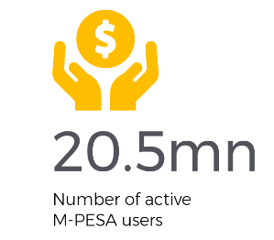
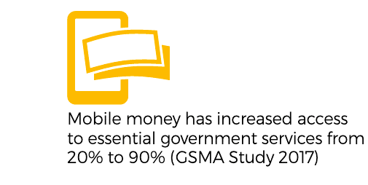

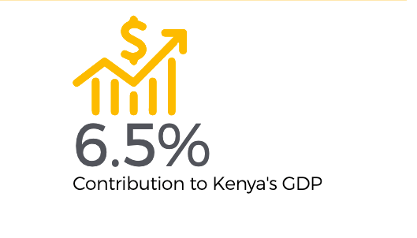

Financial inclusion
Example: m-Pesa
Access and use of M-PESA has lifted 2% of Kenyan households out of poverty
M-Pesa is a mobile banking service that allows users to store and transfer money through their mobile phones with having a bank account.
Mobile money can increase women´s economic participation
Safaricom, Annual Report 2018,
Suri/Jack, 2016
Notes:
Backup example
Background:
M-Pesa is an E-payment service provided by Vodafone, a mobile phone operator, which allows you to bank by mobile phone without the need for a bank account. Services like M-Pesa have revolutionized access to financial services. Digital payments are often the entry point for digital financial services and provide the infrastructure through which additional products can be developed.
Before M-Pesa was introduced, it often took hours to pay an invoice as long queues formed in front of banks, power stations or authorities. These payments have now been simplified and are better protected against corruption as they have become comprehensible and transparent. In addition, it has become much cheaper and easier for the millions of migrant workers to send money home.
The credit can be recharged almost anywhere, but it can also be p-aid out in many places, such as supermarkets or petrol stations. It is also transferable via SMS. Thus transfers (in the meantime also between different offerers) and payments become possible to business and companies. From the hairdresser to the vegetable stall and the bar - almost everywhere you can pay today with M-Pesa not only in Kenya . Originally only intended as a solution for repaying microcredits, M-Pesa quickly proved to be a way of making a wide range of financial services available to people. In addition to directly comparable services such as Airtel Money, there are numerous systems today that are increasingly enabling financial inclusion thanks to digital approaches
While much has been written about the success of mobile money in Kenya, it is in many ways a unique story given Safaricom’s monopoly. Kenya’s DFS trajectory cannot be replicated in other markets, and most regulators and development partners would not want to replicate it anyway—they likely would prefer a more competitive market.
Economic participation of women: Mobile money also appeared to help women move out of agricultural employment and into entrepreneurial or retail employment pursuits. The catalysts for these changes, according to the study authors, is that women have appropriated M-PESA in ways which help them enhance the efficiency of how much time they spend working and how much money they save.
Resources:
https://www.jefftk.com/suri2016.pdf
https://www.safaricom.co.ke/images/Downloads/Safaricom_annual_report_070818.pdf
https://www.ictworks.org/now-scientific-fact-mobile-money-can-lift-women-out-of-poverty/

Slide 21
Financial Inclusion
Wrap Up
Low-income consumers in developing economies have limited access and low sustained usage of financial services.
Fintech provides an opportunity to promote the financial inclusion of low income households in developing countries, whilst recognising the drivers of financial inclusion.
Greater financial inclusion can be a catalyst for eradicating poverty, and for developing especially the small business sector.
Fintech must include both access and usage of financial services focusing on affordability, appropriateness, financial literacy, regulations and fair competition.
Notes:
Source:
https://t20japan.org/wp-content/uploads/2019/03/t20-japan-tf2-10-fintech-strategies-financial-inclusion-sub-saharan-africa.pdf

Slide 22


FinTech - Quiz
2. How many people worldwide do not have a bank account or access to financial institutions via any device?
500 million?
3 Billion
2.2 Billion
2 Billion
Notes:
Answer:
D) 2 Billion
Of the 2 billion adults in the world who do not have access to formal/informal financial services, about 1 billion live in Asia. This is a massive group of people for which technological advances have the potential to improve the standard of living. Furthermore, this population represents a vast market of untapped potential for insurance companies, banks, investment firms and many more.
Resources:
https://www.ict4dconference.org/ict4d-news/ict4d-quick-facts/
https://medium.com/theheartilab/10-facts-about-financial-inclusion-4106676c475d

Slide 23

FinTech - Quiz
Which country has the highest number of FinTech users?
Kenya 🇰🇪
China 🇨🇳
United States 🇺🇸
India 🇮🇳
Quiz questions adapted from IMF blog
Notes:
Goals:
Participants get to know some interesting stats about FinTech as closure of the session
Preparation:
The quiz can either be conducted by simply moving through the slides and asking the participants to raise their hands or via an online tool (to be prepared ahead of the session)
Answer:
China
The EY FinTech Adoption Index (Ernst and Young, 2017) shows that China has the highest percentage of fintech users as a percentage of the digitally active population (69%) followed by India (52%), U.K. (42%), Brazil (40%), and Australia (37%).
Resources:
https://www.ey.com/Publication/vwLUAssets/ey-fintech-adoption-index-2017/$FILE/ey-fintech-adoption-index-2017.pdf

Slide 24

FinTech - Quiz
2. How many more percent of men have bank accounts in comparison to women?
10%
7%
23%
2%
Notes:
Answer:
b) 7%
Globally, more men have bank accounts than women (65% to 58%). This discrepancy is highest in areas of South Asia, where it reaches 55% male vs only 37% female account ownership. Furthermore, of the global unbanked population of 2 billion, 1.1 billion are women.
Resources:
https://www.ict4dconference.org/ict4d-news/ict4d-quick-facts/
https://medium.com/theheartilab/10-facts-about-financial-inclusion-4106676c475d

Slide 25

FinTech - Quiz
3. Bankymoon is:
A company that aims to use blockchain based solutions in developing countries to send money directly to electricity smart meters to provide poor schools with electricity
A company that allows the transfer of medical records from the health institutions to the person directly
A philanthropic company started by Ban Ki-Moon
A company that provides mobile payments services in Zanzibar
Notes:
Answer:
a) Is correct - Banky moon’s Usizo project aims to open poor African schools to an international donor market. Needy schools have Bankymoon meters installed, which are Blockchain-Aware. This means that anybody from around the world can make payments directly to the meter in the crypto-currency of their choice and fund the energy or water needs of the school.
Resources:
http://bankymoon.co.za/

Slide 26
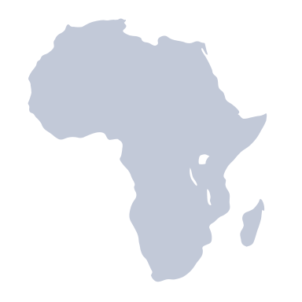
FinTech - Quiz
5. In 5 countries in Sub-Saharan Africa more adults have only a mobile money account than an account at a financial institution – which countries?
Cote d’Ivoire, Somalia, Tanzania, Uganda, and Zimbabwe
Nigeria, Rwanda, Tanzania, Uganda, and Malawi
Cote d’Ivoire, Malawi, South Africa, Benin, and Angola
Angola, Rwanda, Botswana, Chad, and Zimbabwe
Notes:
Answer:
Cote d’Ivoire, Somalia, Tanzania, Uganda, and Zimbabwe (2015)
Mobile money is expanding access to financial services. In 5 countries in Sub-Saharan Africa – Cote d’Ivoire, Somalia, Tanzania, Uganda, and Zimbabwe – more adults have only a mobile money account than an account at a financial institution. Account ownership in Tanzania increased 23 percentage points to 40 percent — and all that growth came from mobile money accounts. In Kenya, 58 percent of adults have a mobile money account, the world’s highest rate.
Source: https://www.weforum.org/agenda/2015/05/the-main-facts-and-figures-about-financial-inclusion-around-the-world/

