Slide 1
Introduction to the dimensions of digitalisation
Module 4.3:
Entrepreneurship
Notes:
Overall learning objective module 4: Participants are aware of specific opportunities and challenges the digital economy brings for businesses on the macro and micro level

Slide 2
Agenda
Module 4.3: Entrepreneurship
Zoom in: The digital start-up scene
Opportunities and challenges of digital entrepreneurship for developing countries
The African innovation hub scene
Notes:
Key message module 4.3: Digital entrepreneurship can be a growth engine for the economy.

Slide 3

Start-up Elevator Pitch
30 min
Sit together in groups and think about a start-up product you want to find investors for
  The product can be fictional or real life-inspired
Prepare an elevator pitch (30sec) to convince the investor of your idea
  Points to be considered:
    What challenge does the product solve?
    What is your competitive advantage?
    What impact does the product have?
Pitch your idea in front of the ”jury”
CreativeArt
Notes:
Procedure:
Participants should get at least 15 minutes for the preparation of the pitch (each group has to choose a pitch presenter at the beginning)
Every pitch team gets 30 sec (trainer does time-keeping) to pitch their product in front of the other teams
After all pitches, the best pitch is voted by applause; the team who gets the most applause is the winner
Timing:
30min
​

Slide 4

Digital Entrepreneurship
Opportunities for developing countries
Contribution to poverty reduction and creation of prosperity
Inclusion of marginalized communities
Local solutions for local challenges
Positive spill-over effects of digital innovations to other sectors
Digital Entrepreneurship
is essential for sustainable development
Employment and income opportunities for youth
Access to investment capital and global markets
Notes:
Key message:
Digital entrepreneurship can be a growth engine for the economy.
Background:
Digital entrepreneurship can strongly contribute to reduce poverty and create prosperity and livelihoods and digital entrepreneurs can reap the benefits of the global market.
Examples: For instance, the success of mobile payments (changes in access to finance will be covered in the next session) in Africa has contributed to financial inclusion across the continent – and set a shining example of what can be accomplished to the world. And the delivery of medicines by drones, also pioneered in Africa, makes urgent medical care available to isolated and rural communities
Young people can develop their capacity to build start-ups and innovative community initiatives by using digital technologies as a support. Digitalization can also create opportunities in sectors such as cultural and creative industries which employ proportionately greater numbers of young people and women.
Digital hubs and scalable digital services and products are emerging in developing countries. In addition to creating growth and jobs they serve as a way to address local problems using digital means (more than 60% of all jobs in Africa could be prone to automation according to the World Banks Digital Dividends report). Digital entrepreneurship is driven by so called "frugal innovation", meaning design of products and services that are affordable and durable, without having a focus on sophistication
Development cooperation can promote digital entrepreneurship in partner countries, for example by providing infrastructure, through education and capacity building or through financial support.
Resources:
https://unctad.org/en/PublicationsLibrary/ldcr2018overview_en.pdf
https://broadbandcommission.org/Documents/publications/DigitalEntrepreneurshipReport2018.pdf

Slide 5
Digital Entrepreneurship
Challenges for developing countries
Restrictions for cross-/border trade
Lack of digital skills in the workforce
Lack of adequate digital infrastructure
Regulatory and administrative burdens
Digital Entrepreneurship
is essential for sustainable development
Insufficient access to finance
Insufficient collaboration between old & new players
Notes:
Background:
Nevertheless, analysis show that businesses - and SMEs in particular - often struggle with digital developments.
Barriers to cross-border trade, regulatory and administrative burdens, insufficient access to finance and digital skills in the workforce. Some of the questions that need to be tackled in the developing world include low investment, poor access to financing, small consumer markets (that limit the growth potential of startups and micro-, small- and medium-sized businesses), an underdeveloped talent base and poorly-performing innovation ecosystems with weak infrastructure and sometimes insufficient collaboration between new companies, universities and existing enterprises
Resources:
https://unctad.org/en/PublicationsLibrary/ldcr2018overview_en.pdf
https://broadbandcommission.org/Documents/publications/DigitalEntrepreneurshipReport2018.pdf

Slide 6

Which start-ups from developing countries do you know?
10 min
Notes:
Procedure:
Ask participants to share their knowledge:
Do they know start-ups from developing countries?
What is their business case?
Do they know about challenges the start-up faces?
Timing:
10min
Names could be written down on card for further reference
Examples for innovative start-ups from Africa:
7keema (Egypt): an on-demand home nursing services platform using mobile, AI, VR and telehealth technologies to ensure peace of mind for patients and higher incomes for nurses;
Appy Saude (Angola): the largest digital health portal of Angola, allowing users to identify and book healthcare service providers;
Complete Farmer (Ghana): a crowd-farming platform that enables users to own agricultural land and manage it remotely from their devices
Leaf (Rwanda): provides financial services to the stateless and excluded by creating a virtual bank with blockchain technology
OZÉ (Ghana): a mobile platform that empowers small business owners to make data-driven decisions to improve their performance and access capital
Bitland (Ghana): uses blockchain technology to create tamper-proof digital public records to help people prove their land belongs to them.
Babymigo (Nigeria): online community that connects mothers-to-be with information, medical experts, services and other parents
Ona (Kenya): uses satellite imagery and information from NGOs to create a simple digital mapping system
Resources:
https://www.appsafrica.com/10-startups-selected-to-pitch-live-at-africa-startup-summit/

Slide 7
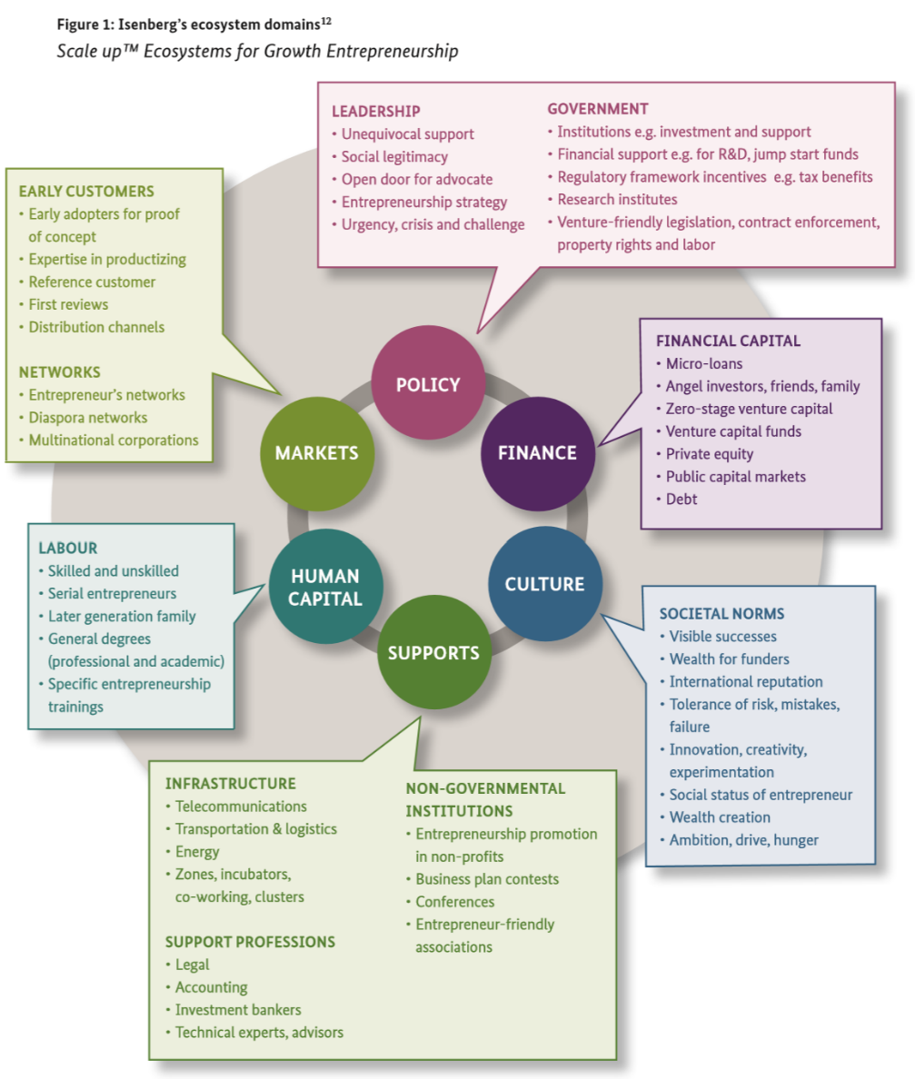
Entrepreneurship
Ecosystem
Innovation and Entrepreneurship requires access to different services.
Different definitions of such an entrepreneurial ecosystem exist.
6 basic elements
Source: GIZ (2018): Guide for Mapping the Entrepreneurial Ecosystem
Notes:
Key message: New business models change the development sector and the relations between actors.
Background:
Start-ups are young companies that pursue an innovative business idea and want to establish themselves on the market. Until they are established on the market - if they succeed (more than every 2nd start-up fails).
Start- ups are created in very different industries, but a large proportion of them work in the tech sector. So called Tech start-ups develop ideas and solutions based on digital technologies and the Internet, such as special apps or web services. There are also many Social Start-ups that develop sustainable solutions to local or global problems.
A start-up ecosystem is formed by entrepreneurs, startups in their various stages and numerous types of organizations such as universities, investors, accelerators/co-working spaces (physical places for collaboration and innovation), legal and financial service providers and government agencies. The composition and maturity level of the ecosystem are an essential component for the success rate of start-ups and entrepreneurs on a larger scale. A good understanding of their respective state, strengths and weaknesses enables more specifically targeted policies, enhances investment decisions (and also improves the impact of development cooperation).
Digital entrepreneurship and innovation create an ecosystem to bring the digital economy to life—with new, growth-oriented ventures and transformation of existing businesses— contributing to net employment growth and helping to enhance the competitiveness and productivity of the economy. Digital entrepreneurship offers new products and services, leverages new technologies and business models, and opens new markets. Vibrant digital entrepreneurship ecosystems encompass skill development (for example, through business mentoring networks), ecosystem support infrastructure (accelerators, incubators, innovation hubs, and co-working spaces), and access to markets and early-stage financing (seed financing and venture capital). These ecosystems require a conducive and enabling business environment that motivates the creation and use of novel digital technologies.

Slide 8
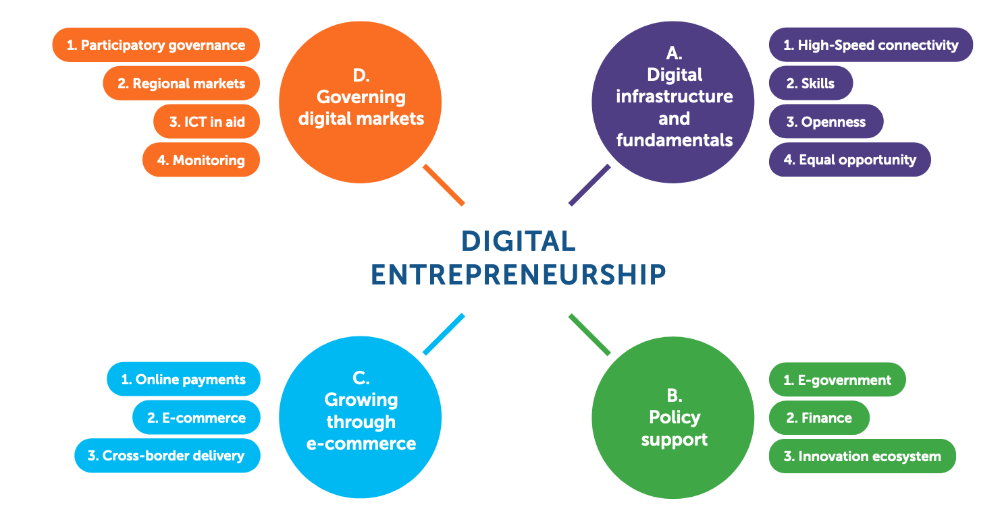
Entrepreneurship
Intervention dimensions for DevCo
By Working Group Digital Entrepreneurship, Broadband Commission, September 2018
Notes:
Background:
In 2018, the Broadband Commission Working Group on Digital Entrepreneurship presented recommendations to foster digital entrepreneurship.
The report proposes action in four key areas:
1) good management of the broad economy (including high speed connectivity, human capital development, innovation and equal opportunities),
2) measures to stimulate e-commerce, and
3) better regional and global cooperation and collaboration.
4) additional policy support for digital entrepreneurship
Suggestions:
- Use e-government tools to make it easy to start, run and end a company: The cost and time of setting up a business in many developing countries remain high. It takes 45 days to set up business in South Africa and 90 days in Somalia.42 In Sub-Saharan Africa, the average time to set up a business is 25 days compared to four days in Europe
- Help businesses find funding: Small businesses, particularly in developing countries, struggle to get access to sufficient financial resources to start and grow. Lack of investment also means a lack of access to the skills and know-how that typically goes with it.
- Build more and better innovation ecosystems: Start-ups and digital companies do not grow in isolation. They require an innovation ecosystem to ensure support and collaboration with a wide set of organisations. Use of government´s convening power to bring stakeholders together.
Sidenote Gender Digital Divide in Entrepreneurship, Example Togo:
In Togo, since February 2018, the National Agency for Promotion and Financing Guarantee of MSMEs officially set aside 20% of public procurement contracts for young and female entrepreneurs, who may benefit from simplified procedures, and with considerably reduced costs and timing.
Examples for policy interventions:
Tunisian Start-up Act (see slide 10)
I4Policy (see slide 9)
Resources:
https://broadbandcommission.org/Documents/publications/DigitalEntrepreneurshipReport2018.pdf

Slide 9

Example: Tunisia start-up Act
Notes:
Background:
Governments are generally not very good at picking technology winners. Nor can they easily create technology clusters, which tend to grow organically, where the right conditions are in place, as firms draw upon the same talent pool and startups spin off from established enterprises. But government policy can help to sustain an emerging technology cluster, for instance by instituting favorable tax regimes or liberal policies on awarding employment permits to skilled workers (“tech visas”).
Example Tunisia:
The Tunisia Startup Act (as part of the broader Digital Tunisia 2020 strategy), is a law made to ease starting and running of businesses in Tunisia. While the law is not limited to tech startups, the law provides that all new businesses wishing to benefit from the law must utilise a great amount of technology in running its business. The Startup Act is expected to increase the number of startups, especially in the high-tech sector, making innovative entrepreneurship in Tunisia more competitive internationally and potentially increasing economic growth and employment, especially among youth.
What are the Benefits of this Law?
This law if well implemented will create huge opportunities and ease doing business for entrepreneurs in Tunisia. Some of the major perks provided for by the Act include:
Tax exemption for up to 8 years
Exemption from Capital Gain Tax on Investment made in Startups
Salary for up to three founders
Up to a year leave is granted to Private or Public Employees
Provisions for government funding program for Startups: Not just from investors, or venture capitalists, but through government funds and grants
Government Assistance and Fast tracking of International Patents
Resources:
https://www.startupact.tn/accueil.html

Slide 10
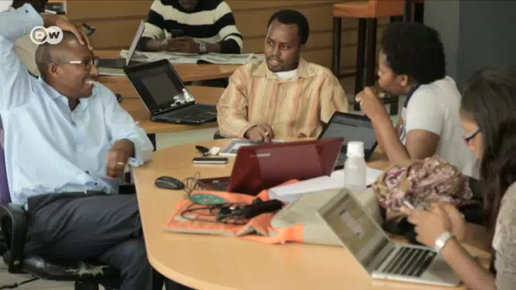
Digital Entrepreneurship
Focus Africa
Notes:
Video: The Deutsche Welle (DW) - foreign German broadcasting station (duration: approx. 1min) about the thriving African tech innovation scene
Source: https://www.dw.com/en/kenyas -startup-community/av-47272721

Slide 11

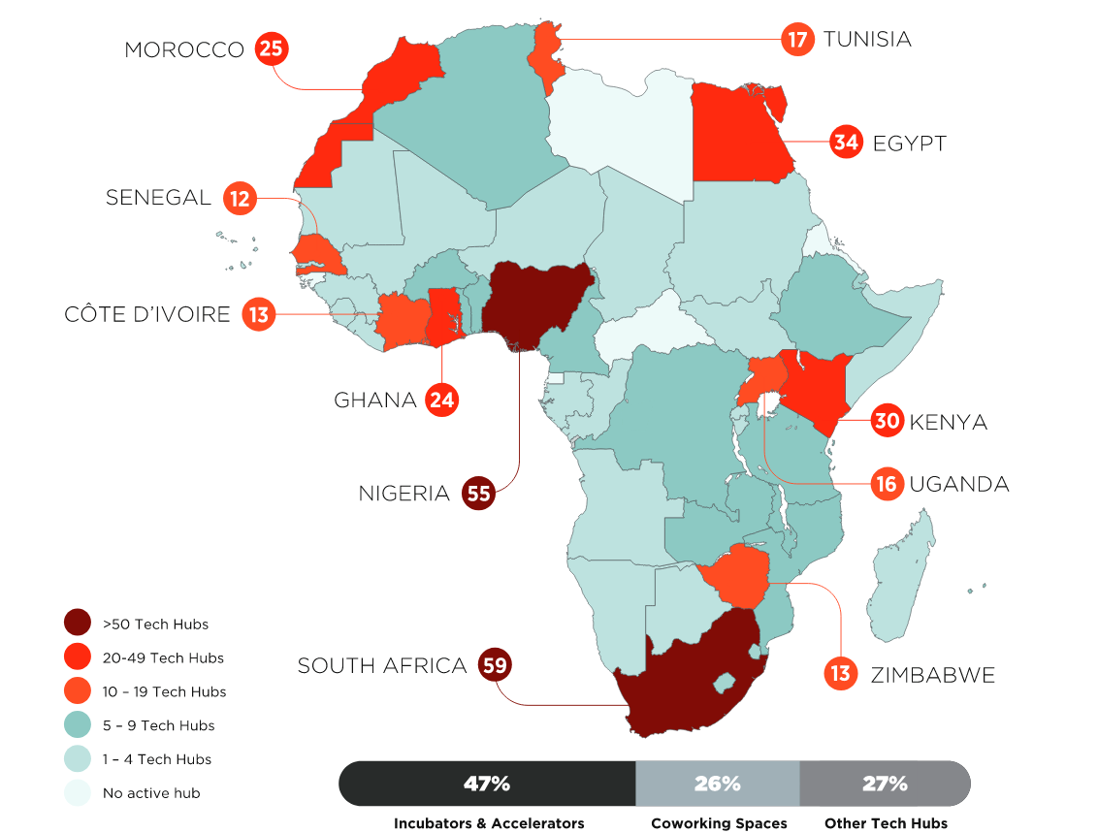
Fastest growing Ecosystems
2016-2018
Democratic Republic of the Congo +200%
Zambia +200%
Cote d´Ivoire +160%
Top 3 Ecosystem Cities, by number of active tech hubs
Lagos, 31 hubs
Cape Town, 26 hubs
Nairobi, 25 hubs
442 active Tech Hubs
GSMA, Tech Hubs Landscape 2018
Notes:
Key message: Innovative business models are creating new dynamics between formal companies and informal micro-entrepreneurs.
Background:
Innovation hubs play an important role in Africa's ever-growing start-up ecosystem. According to a GSMA report, there were already 442 hubs in Africa by mid-2018 - compared to 2016, the sector grew by 50 percent. The innovation centres have cooperation partners and investors. Local actors can network and find like-minded people. The projects that emerge in the hub ecosystem are mainly tech start-ups, but also from other sector like renewable energies or agriculture. Innovation hubs support the creation of new jobs in these sectors and the development of innovative solutions to local problems. This improves the quality of life for many people. Development cooperation therefore supports the creation and promotion of innovation hubs in developing countries. The average age of the active tech hubs is 5 years.
GSMA defines tech hubs as physical spaces designed to support and foster start-ups. These includes incubators, accelerators, co-working spaces, fab labs, makers spaces, hacker spaces, and other innovation centres. Active tech hubs are defined as hubs that have shown active digital presence (website, news, social media) since October 2017.
This growth over the past two years has been accompanied by three trends. First, several tier-2 ecosystems and new ecosystem cities (beyond South Africa/Cape Town, Nigeria/Lagos, and Kenya/Nairobi) have emerged across the region as internationally attractive technology centres. Second, the volume of funding raised by tech start-ups all across the continent soared. Third, an increasing questioning and urge to rethink flawed business models has led several hubs and programmes to narrow down their offering and target specific niches.
About 12% of the active hubs are now either run or backed by a local mobile operator. MTN, Vodacom, and Orange appear as the most active operators in Africa when it comes to running or engaging with local tech hubs. A few recent examples in Africa include MTN in-house incubators “Y’ello Startups” launched in 2017 in Côte d’Ivoire and Congo. A recent trend is the rise of industry-focused programmes run by large corporation such as the Nairobi-based Merck Accelerator. Similarly, a growing number of tech hubs are now devoted to financial technology services. These include Barclays’ Rise in Cape Town. Some organisations are even focusing only on blockchain technologies (e.g. BitHub in Kenya.
Resources:
https://www.gsma.com/mobilefordevelopment/wp-content/uploads/2018/03/Africa.pdf

Slide 12
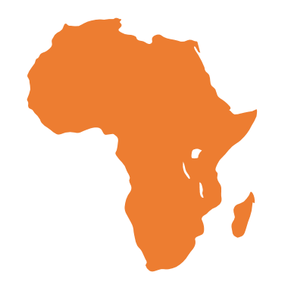
Digital Entrepreneurship Africa
Hype or Hope?
"Digital innovation is the best way to provide the solution made by, and for African people" (Macron, 2018)
Rising numbers of technology hubs and innovation incubators
Strong entrepreneurial mindset
Lack of evidence regarding effectiveness of hubs and innovations initiatives
Regulatory and administrative barriers and gaps
Digital entrepreneurs gave rise to a number of ground-breaking innovations (e.g. M-Pesa mobile money revolution)
Persistent divides between countries and within countries
Mixed numbers regarding access to venture capital, disruption of value chains and global scale
Variety of initiatives by philanthropists, development organisations, technology corporations, and local governments
Limited participation in global digital production
Notes:
Procedure:
Slide can also be used as a starting point for a concluding discussion on the potentials and challenges of digital entrepreneurship and the different narratives that exist on the topic
Rising numbers of technology hubs and innovation incubators:
There were 442 hubs in Africa by mid-2018
Groundbreaking Innovations:
The recent success of mobile payment platforms, such as M-Pesa has shown how start-ups can solve long-standing seemingly intractable development problems.
Variety of initiatives by philanthropists, development organizations, technology corporations, and local governments
Examples for large-scale initiatives of the recent years: the GSMA Innovation Fund injected mentorship and between $1 and $2.3 million into African digital enterprises in just its first round( Mulligan, 2017); the World Bank’s XL Africa program created an elite community of 20 start-ups from across the continent and connected them to investors (Kapil, Andjelkovic, & Lu, 2018); and Google’s Nigeria-based accelerator funded start-ups with $3 million, in addition to in-kind support(Jackson, 2018).
BUT
Lack of evidence regarding effectiveness of hubs and innovations initiatives
No valid data on effectiveness/quality of services of tech hubs; difficulties in differentiation between hub models/stakeholder.
Persistent divides exist within Africa: a few countries (South Africa, Kenya, Nigeria) account for almost all digital entrepreneurship activity. Countries such as Ghana, Tanzania, Senegal, Cameroon, Uganda, Tunisia, Morocco, Cote d’Ivoire, Mauritius, and Rwanda account for a noteworthy but much lower level. Most African nations show activity levels that appear negligible in international comparison. Also within countries, extreme divides exist: the user base for most types of digital products can be found almost exclusively in large cities, that is, close to where the enterprises themselves are located
Mixed numbers
the average African digital enterprise does not grow exponentially, does not scale internationally, does not attract venture capital, and does not disrupt cumbersome analogue value chains. Instead, we see entrepreneurs who are creatively and productively applying and adapting digital technologies to their local economic, social, and political contexts. This has many of the wished-for positive socio-economic effects, just not at the rate and scale that the widespread narratives suggest
Limited participation in global digital economy
While apps like YouTube, WhatsApp, and Facebook have achieved continent-wide reach, there are no African-made, African-owned, or Africa-based smartphone apps that are widely used within or outside of the continent, and even leading African nations only represent a fraction of the global app economy (Caribou Digital, 2016). Similarly, for measures of digital production available at global scale, Africa barely shows up in the statistics
=> a Geonet study (Ojanerä, Graham, Straumann, Sabbata, & Zook, 2017) examining Africa’s knowledge production in comparison with other world regions juxtaposed traditional form of knowledge production (academic articles) with Internet-enabled forms(GitHub commits, that is, contributions to the world’s largest coding platform, and website domain registrations). The findings confirmed prior research showing Africa’s extremely limited share of academic work globally, but they also highlighted that Sub-Saharan Africa seems to play an even smaller role for global digital production: despite having about 13% of the world’s population, only 0.5% of GitHub commits and 0.7% of domain registrations come from Sub-Saharan African nations

Slide 13
Digital Entrepreneurship Africa
Success Story – Kenya
Kenya is home to one of the most established innovation ecosystems in Africa. Homegrown successes such as M-Pesa are driving Internet adoption throughout the country, transforming Kenya into a digital first nation.
Kenya has one of the most thriving innovation ecosystems in Africa
New investments projects are helping to create more sustainable businesses (Venture capital funding for start-ups in Kenya jumped from $92.7 million in 2016 to $147 million in 2017)
But:
Kenya’s education system needs to embrace critical and innovative thinking to meet the demands of the digital society
Digital divide between rural and urban areas needs to be tackled
SpeakUp Baromenter 2019, Deutsche Welle Akademie
Notes:
Background:
The story of digital innovation in Kenya is the story of M-Pesa, Ushahidi and the iHub. It’s these local inventions that have triggered digital participation and given Kenya a reputation for developing digital solutions. The success of crisis mapping tool Ushahidi, mobile money service M-Pesa, and the tech incubator iHub have led to Kenya being dubbed the “Silicon Savannah” of Africa, home to one of the oldest and most flourishing start-up scenes on the continent.
Thanks to its high Internet penetration rate, fast Internet speed, and use of English as its national language, Kenya is an attractive environment for digital entrepreneurs and investors. Supportive tech policies are helping in the development of infrastructure, creation of local content, and public-private partnerships.
Kenya’s innovation scene is no one-hit wonder. Today, Nairobi is home to more than 30 tech hubs and incubators, giving space to developers, designers, researchers and entrepreneurs to work on new technological solutions.
Venture capital funding for start-ups in Kenya jumped from $92.7 million in 2016 to $147 million in 2017 – the second highest level on the continent after South Africa, according to Partech Ventures (Quartz 2018).
The digital divide between the countryside and rural areas is a major barrier in promoting digital entrepreneurship across the country. Another challenge is the reform of the education system: Kenya’s education system should stimulate critical thinking. In order to create digital entrepreneurs, Kenya needs to modernize its education system.
Resources:
https://www.dw.com/downloads/47307776/dw-akademiespeakup-barometerkenya.pdf

Slide 14

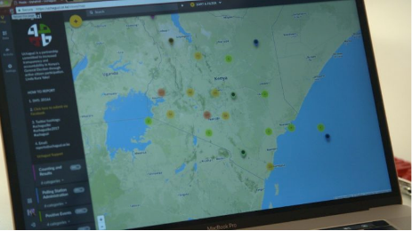

Digital Entrepreneurship Africa
Success Stories
The Kenyan start-up BRCK has developed SupaBRCK and PicoBRCK to bring cost-effective Internet to remote locations and enable data updates from these areas.
Ushahidi is one of the most famous software solutions made in Kenya. It was first developed in 2008 to monitor the Kenyan Elections, but soon became a global provider for crisis mapping and monitoring.
Jumia is the leading pan-Africa e-commerce platform with over 3,000 employees in 14 countries spanning across 6 African regions.
Matibabu is an Ugandan e-health start-up that developed a non-invasive diagnostic kit used to detect Malaria.
Notes:
.
Background:
BRCK: BRCK is a Kenyan hardware producer, who is about to innovate the African connectivity and education sector with solutions made in Africa. Founded in 2013, BRCK first started with the BRCK v1, a modem, that was made for areas with regular power shortages. Since then, the company built a whole digital world around the idea of connectivity. The BRCK v1 was succeeded by the SupaBRCK, a device which combines the modem, a server, a storage and much more. But most important is the idea of free WIFI and the new intranet platform “Moja”, that comes along with the SupaBRCK and intends to revolutionize the connectivity problem of the frontier markets of the global south.
Ushahidi: Ushahidi, which means “testimony” in Swahili, is one of the most famous software solutions made in Kenya. t was first developed in 2008 to monitor the Kenyan Elections, but soon became a global provider for crisis mapping and monitoring, as well as a project-specific map provider. An interesting part of Ushahidis work is their handling of the digital barrier in certain areas. During important crisis projects, Ushahidi works with its team and volunteers worldwide to transform SMS and Mails into Data for the map. This is an essential part of the map solution, because otherwise big parts of societies across the world would be excluded of the new, sometimes life-saving solution.
Jumia: Nigeria-based e-commerce start-up Jumia is going public on the New York Stock Exchange. The tech firm is considered to be Africa's first unicorn — a privately held start-up valued at more than $1 billion (€890 million).
Matibabu: the start-up from Uganda developed a test kit that can detect malaria using a beam of light to test a patient’s finger. The test kit called Matibabu or “treatment” in Swahili is connected to a phone or laptop where it relays results. A red beam on the kit detects changes in the shape, colour and concentration of red blood cells, affected by the malaria parasite.
Resources:
These short (each approx. 1-4min) videoclips show more start-ups ideas from Africa from sectors ranging from education to e-agriculture: https://www.arte.tv/en/videos/RC-016127/digital-africa/

