Slide 1
Introduction to the dimensions of digitalisation
Module 3.2.1 Deep Dive: Cyber Security
Notes:
Overall learning objective module 3: Data is the currency of the digital transformation and needs to be contextualized within layers of DevCo

Slide 2
Agenda
Module 3.2.1: Deep Dive: Cyber Security
Introduction Cyber Security
Status-Quo
Threats
Roles & Responsabilites
Cyber Security Governance
Practical Guidance and Policy Design
Notes:
Key message Module 3.2.1: All stakeholders of the digital ecosystem (individuals, private and public sector) need to build privacy and security issues as an integral part of their DNA.

Slide 3
What is Cyber Security?
Notes:
Procedure:
Trainer asks participants to write down their definitions of cyber security in the downloaded online tool. Trainer afterwards displays or reads out some of the definitions provided. No participant discussion at this point. Trainer can refer back to answer provided during the module.
Timing:
10min

Slide 4

Deep Dive: Cyber Security

Slide 5
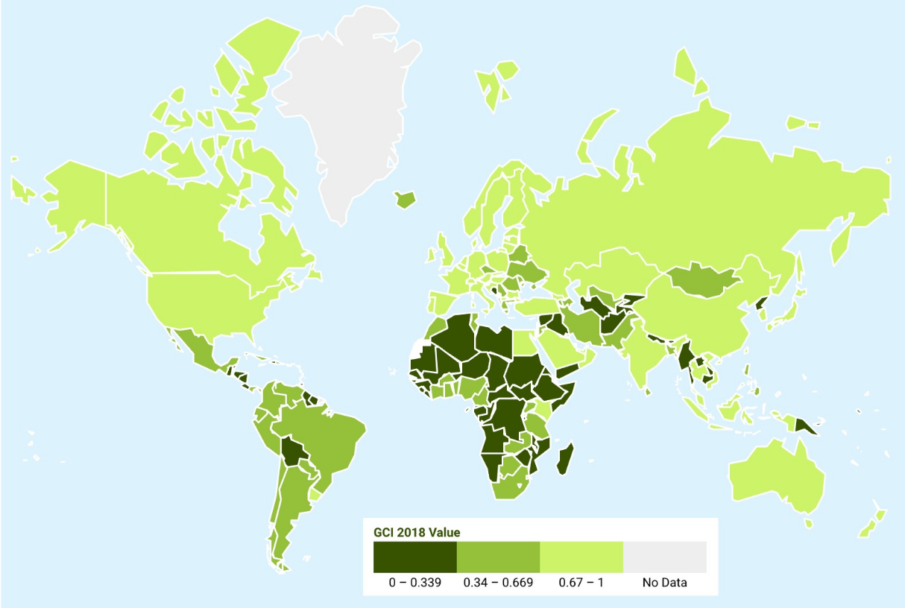
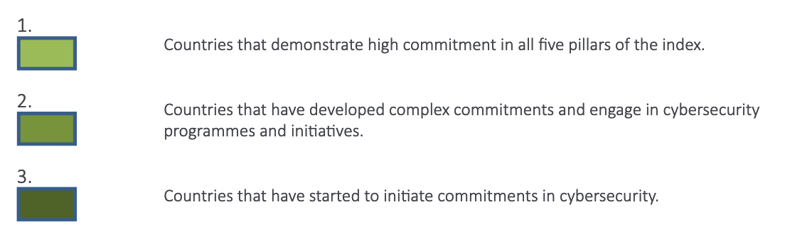
Heat map of national Cyber Security commitment
ITU Global Cyber Security Index 2018
Notes:
Background:
The Global Cybersecurity Index (GCI) developed by the International Telecommunication Union (ITU) is an initiative to measure the commitment of countries to cybersecurity. GCI focuses on five categories: legal, technical, organizational, capacity building and cooperation.
Data from the 2018/2019 ITU Cybersecurity Index Report show that awareness on cyber security issues raises worldwide:
In 2018, cybercrime legislation is globally well implemented. Most countries have cybercrime legislation (91%), which improves on 2017 (79%). But laws should not be adopted and left redundant, governments need to use laws as a framework to implement strategies that ensure government ICT initiatives are sustainable, in compliance with information technology authorities, and enhancing cybersecurity.
In 2018, the majority of countries (58%) reported having a national cybersecurity strategy (NCS), which is an increase from last year (50%), and 47 per cent have metrics to measure cybersecurity development at a national level, which is also an improvement, since in 2017 only 21 per cent had metrics.
The majority of countries (66%) implement awareness campaigns up from 59 per cent in 2017, in addition to giving professional training courses in cybersecurity
Examples for countries with high national cyber security commitments: Germany, Sweden, Australia, Saudi Arabia, Kenya, Vietnam, Indonesia
Examples for countries with low national cyber security commitments: Costa Rica, Senegal, Lebanon, Namibia, Angola
BUT also keep in mind: The cyberspace is borderless so any online threat emanating from anywhere in the world can spread anywhere and affect anyone. The map matters when talking about capacity building, partnerships and budget allocation etc.. => Cyber Security is a global challenge.
Example (optional): The owner of a smart TV may not even notice that their device is being used for attacks that cause harm elsewhere on the globe. The congestion of DDOS-attacks can be so severe to sometimes cut off entire countries like Liberia from the Internet. In 2016,Liberia became a target for the Mirai botnet (internet-connected devices), leading to widespread disruptions and demonstrating just how devastating distributed denial-of-service attacks can be, especially when they get executed using tens of thousands of hijacked, internet-connected devices.
Resource: ITU, Global Cyber Security Index https://www.itu.int/en/ITU-D/Cybersecurity/Pages/global-cybersecurity-index.aspx

Slide 6
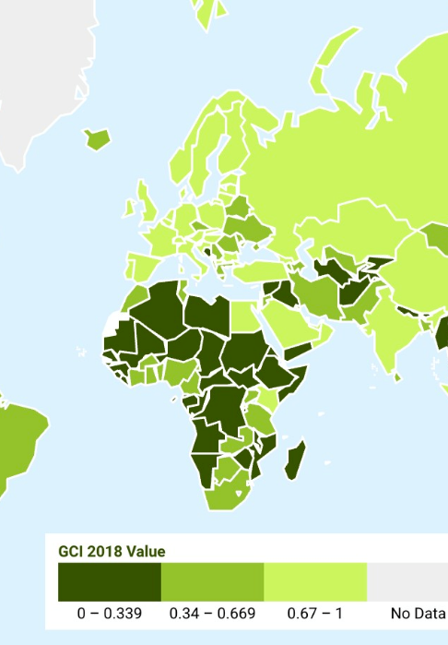
Cyber Security Status quo in Africa
Few governments in the region have implemented national cyber strategies
Only 20 percent of the African states have implemented a legal framework for cybersecurity, and only 11 countries have enacted substantial laws to fend off cybercrime
Cybercrime in Africa is becoming more sophisticated and creating significant financial losses: Cybercrime cost Africa an estimated US$3.5bn in 2017
Notes:
Background:
Few governments in the region have implemented national cyber strategies (African Union Commission 2016).
For the African region, Kenya and Rwanda rank highest in ITU Cyber Security Index. In countries where laws and procedures are already in place, legislative cycles are always playing catch-up with the fast pace of innovation in the digital economy.
The Computer Misuse and Cybercrimes Act in Kenya aims to combat financial losses that primarily result from banking malware and card skimmers (Serianu 2017). Serianu estimates the cost of cyber-crime in Kenya at US$210m in 2017, and more than 4,500 cyber-threats were detected by the country's Computer Incident Response Team in the fourth quarter of 2017 alone. Nonetheless, the legislation is controversial, with opponents criticising the potential impact on freedom of expression.
Only 20 percent of the African states have implemented a legal framework for cybersecurity, and only 11 countries have enacted substantial laws to fend off cybercrime
In May 2016 Rwanda's parliament passed cyber-crime legislation designed to allow the state's security agencies to investigate any threats and prosecute cyber-crimes in private and public institutions. According to the National Bank of Rwanda (the central bank), more than 1,000 cyber-attacks a day were defeated, although it did not give any data on successful attacks
Cybercrime in Africa is becoming more sophisticated and creating significant financial losses. Cybercrime cost Africa an estimated US$3.5bn in 2017
More than 90% of African businesses, in the public and private sectors, lack the basic requirements to ensure minimum levels of cyber-security, and so protect themselves against losses. This situation is exacerbated by the lack of technology and skills to stave off those attacks. Over 90 percent of African businesses—and, particularly, SMEs—are operating below the cyber security poverty line. That is, these businesses do not have the skills and resources to protect, detect, and respond to cybersecurity threats. Many enterprises lack a holistic understanding of their cyber risks and an effective strategy to address them
Ethiopia alone faced 256 "major" cyber-attacks in a six-month period in 2017, according to the local Information Network Security Agency. African states continue to be affected by global ransomware attacks—11 regional states were hit by the global WannaCry attack in 2017, for example.
Resources:
https://openknowledge.worldbank.org/handle/10986/31499

Slide 7
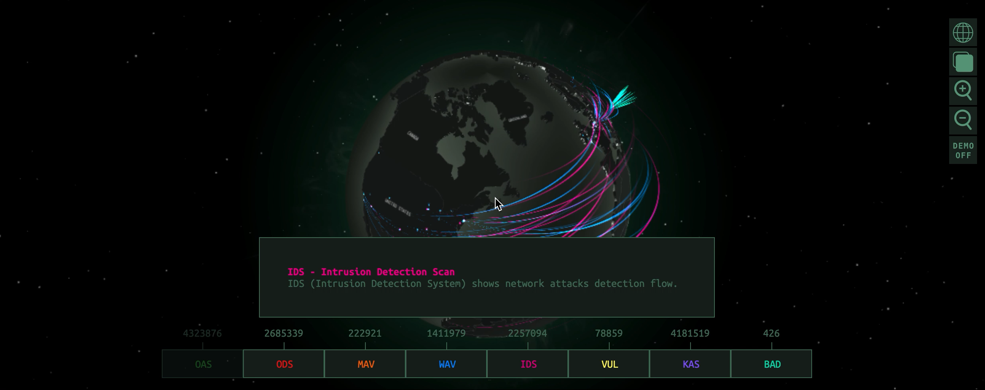
Cyber attacks are growing and become more sophisticated
Source: Kaspersky Cyber Threat Map
Notes:
Background:
Kaspersky Cyber Malware and DDoS Real-Time Map
Activities detected by the map:
On-Access Scan
On-Demand Scan
Mail Anti-Virus
Web Anti-Virus
Intrusion Detection Scan
Vulnerability Scan
Kaspersky Anti-Spam
Botnet Activity Detection
What’s a cyber attack map?
A cyber attack map is just a fancy, graphical way to show how the Internet works. Day by day, millions of cyber threats hit new victims; some of them performing counter attack, others mitigating the attacks and remaining passive. While some of these malicious activities are manually-targeted cyber attacks, most of them are botnets dedicated to shutting down infrastructures and causing chaos among organizations.
Most current digital attack maps share a few common facts:
They are wrongly advertised as “live maps”—most do not show live attack data, but records of past attacks.
They are focused on showing Distributed Denial of Service (DDoS) attacks only, and not other types of cybercrime.
They only show anonymous traffic data
Are cyber attack maps really useful?
Some infosec industry experts believe these maps aren’t useful at all, that they’re merely used as a sales tool by cybersecurity solution providers.
Based on our experience, while these threat maps have no practical usage for mitigating attacks, they can be utilized to explore historical attack trends, to understand raw data behind DDoS attacks (which, most of the time, is not intuitive for new technical users) or to report outages on certain dates to their customer base.
Something important to keep in mind, about the source of the attacks: while these maps locate specific countries launching attacks against others, that doesn’t mean the actual source of the attack is the same as the attacker location.
Most of the time, the source of an attack is forged, made to appear as though it was initiated from a certain country When it shows the right location, it’s often not the real attacker behind the dirty work, but an infected computer working for a botnet.

Slide 8



Vulnerability and threats affect all stakeholders
Adapted from European Cyber Security Perspetives 2018
Source of threat | Governments | Private Organisations | Citizens
Professional criminals | Disruption of IT Manipulation of information Theft and publication or selling of information IT takeover | Disruption of IT Manipulation of information Theft and publication or selling of information IT takeover | Disruption of IT Manipulation of information Theft and publication or selling of information IT takeover
State actors | Digital espionage Offensive cyber capabilities Theft and publication of information | Digital espionage Offensive cyber capabilities Theft and publication of information | Digital espionage
Terrorists | Disruption/Takeover of IT | Disruption/Takeover of IT | Theft and publication of information
Cyber vandals and script kiddies | Theft of information Disruption of IT | Theft of information Disruption of IT | Theft of information
Hacktivists | IT Takeover Theft and publication of obtained information Defacement | IT Takeover Theft and publication of obtained information Defacement | IT takeover
Internal actors | Theft and publication or selling of obtained information Disruption of IT | Theft and publication or selling of obtained information Disruption of IT | IT takeover
Private Organisations |  | Information theft (industrial espionage) | Commercial use/abuse or “resale” of information
No actors | IT failure | IT failure | IT failure

Slide 9
Cyber-related security threats are not always adequately addressed
Video UN University: “The Future of Cybersecurity”, a conversation with Melissa Hathaway, who served as a senior cybersecurity adviser to both President George W. Bush and President Barack Obama, leading a major Cyberspace Policy Review for the latter
Min 08:20-11:54 (Topic: Major threats CS)
Source: https://www.youtube.com/watch?v=RgOZFKZE3ks
Notes:
Description:
Video UN University: “The Future of Cybersecurity”, a conversation with Melissa Hathaway, who served as a senior cybersecurity adviser to both President George W. Bush and President Barack Obama, leading a major Cyberspace Policy Review for the latter
Possible sequences for presentation (different focus)
Min 08:20-11:54 (Topic: Major threats CS)

Slide 10

Cyber Security Group discussion: Country assessment
What is the current state of discussion on cyber security policy in your country?
What are the major threats?
What are the policy objectives?
What are the existing institutional capacities?
10 min
Notes:
Procedure:
Trainer asks participants to share experiences from their own working context. A choice of the answers can also be mapped on a flipchart by trainer for later reference
Timing:
10min
Sources:
https://www.iss.europa.eu/sites/default/files/EUISSFiles/Operational%20Guidance.pdf

Slide 11
Cyber Security affects everyone
Video UN University: “The Future of Cybersecurity”, a conversation with Melissa Hathaway, who served as a senior cybersecurity adviser to both President George W. Bush and President Barack Obama, leading a major Cyberspace Policy Review for the latter
Min 17:30 (Topic: CS affects everyone: What can countries/companies/individuals do?)
Source: https://www.youtube.com/watch?v=RgOZFKZE3ks
Notes:
Description:
Video UN University: “The Future of Cybersecurity”, a conversation with Melissa Hathaway, who served as a senior cybersecurity adviser to both President George W. Bush and President Barack Obama, leading a major Cyberspace Policy Review for the latter
Possible sequences for presentation and discussion (different focus)
Min 17:30 (Topic: CS affects everyone: What can countries/companies/individuals do?)
Source: https://www.youtube.com/watch?v=RgOZFKZE3ks

Slide 12
Group Discussion: Cyber Security affects everyone
Split into three groups and put yourself in the shoes of one of the three stakeholders:
National Governments
Private Sector
Individuals/Civil Society
What are the interests and responsibilities of each stakeholder with regards to Cyber Security?
20 min
Freepik/Creative 32965
Notes:
Preparation (ahead of training):​
4-5 Flipcharts plus sufficient cards and pens (depending on total group size) in different corners of the rooms with the following labels
Stakeholder Mapping (title for all flipcharts)
Task: Map stakeholders and their interests and responsibilities (task for all flipcharts)
Divide each flipchart in two columns with the following titles: 1) Key interests and 2) Responsibilities
Each flipchart now gets one institution for which key interests and support capacities shall be mapped by the participants
The institutions are: National Governments, Private Sector, Individuals/Civil Society
Timing (20min):
Participants should get at least 15 minutes for the mapping and 5 minutes for a short presentation of the results in the plenary (each flipcharts group therefore shall nominate a spokesperson in the beginning of the mapping)
Procedure:
Split up the participants into groups of 4-5​ per flipcharts
Explain the exercise: Mapping of key interests and tasks of each stakeholder plus short wrap-up presentation for the plenary in the end
Trainer will walk around and support participants if necessary
Example for explanation of the procedure: Institution: National courts; Interests: Providing justice to perpetrators and victims; Ensuring rule of law and protection of human rights; Capacity/Tasks: Law-shaping and law-making; Sanctioning powers
For details on potential answers for the flipcharts see p. 72 of EC´s „Operational Guidance for the EU’s international cooperation on cyber capacity building“ https://ec.europa.eu/europeaid/sites/devco/files/guidelines-cybersecurity-na-20180820_en.pdf
​

Slide 13
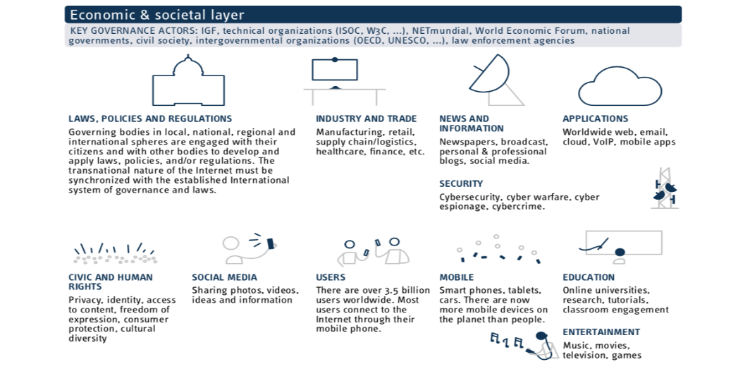
Cyber Security Responsabilites for everyone
ICANN 2015
Malabo Convention African Union
Cyber Security as part of the business strategy:
Protect valuable intellectual property and business information against theft and misuse.
Legal & Regulatory framework:
Protect society against cybercrime and promote a safe and secure cyber-environment.
Cyber Hygiene and Awareness:
Establish and maintain routines, checks and general behaviour required to stay safe online.
EU Cyber Security Act
Notes:
Background:
Tasks/ Reponsabilities for the three stakeholder groups:
Governing bodies:
Government’s role in cybersecurity will only grow as the global demand and dependency on the internet and internet-connected devices continue to increase. With increasing threats and fewer opportunities to fail, governments must rise to the challenge to protect both national security and economic prosperity. Tasks: Development of a legal and regulatory framework to protect society against cybercrime and promote a safe and secure cyber-environment. Such a framework could include: the adoption of legislation that defines what constitutes illegal cyber-activity; legal recognition of individual rights and civil liberties; establishment of compliance mechanisms; the building of capacity to enforce the framework; institutionalisation of critical entities; and international cooperation to fight cybercrime.
Examples for frameworks:
Malabo Convention African Union
The African Union member states in 2014 adopted the African Union Convention on Cyber Security and Personal Data Protection, also known as the Malabo convention. The convention encourages AU member states to recognise the need to protect critical cyber/ICT infrastructure, personal data and to encourage free flow of information with the aim of developing a credible digital space in Africa.
In June 2019 Rwanda becomes the fifth country to ratify the framework after Senegal, Mauritius, Namibia and Guinea.
EU Cyber Security Act
The EU Cybersecurity Act entered into force on 27/06/2019. It revamps and strengthens the EU Agency for Cybersecurity (ENISA) and establishes an EU-wide cybersecurity certification framework for digital products, services and processes. The EU Cybersecurity Act introduces for the first time an EU-wide cybersecurity certification framework for ICT products, services and processes. Companies doing business in the EU will benefit from having to certify their ICT products, processes and services only once and see their certificates recognised across the European Union.
More information: https://www.ispionline.it/en/pubblicazione/geopolitical-meaning-europes-cybersecurity-act-22870
Industry and trade:
The combination of advances in enterprise technology and more effective malevolent actors is complicating the task of protecting business processes and information. Companies must now fend off ever-present cyberattacks—the threat of cybercriminals or even disgruntled employees releasing sensitive information, taking intellectual property to competitors, or engaging in online fraud. While sophisticated companies have recently endured highly public breaches to their technology environments, many incidents go unreported.
Individuals:
Cyber Hygiene & Awareness
People are often mentioned as the weakest link and the most important asset in the cybersecurity chain. Increasingly sophisticated types of cybercrime – e.g. new methods of spear-phishing and social engineering – put the users on the losing end and make it very difficult for policymakers and companies to keep up. How-ever, most attacks are made possible due to human error or irresponsible behaviour. More worryingly, such behaviour does not always stem from the lack of information but also from conscious decisions to ignore established practices for enhancing security and safety online, e.g. on password protection or opening links from unknown sources
Overall, most programmes and initiatives focused on cyber hygiene and awareness aim to promote ‘good health online’. That involves identifying, prioritising and responding to risks in five main spheres: perimeter, network, individual devices, the cloud and the supply chain.105 Several delivery methods exist to ensure reach-ing broad audiences, including through brochures, newsletters, handbooks, training and awareness courses, interactive cybersecurity websites, exercises and viral marketing campaigns.106 To address the growing need for cybersecurity professionals, several countries faced with a skills shortage organise regular competitions for students and professionals to find cyber talent and encourage people to pursue a career in cybersecurity.
Resources:
https://www.iss.europa.eu/sites/default/files/EUISSFiles/Operational%20Guidance.pdf (p. 17).

Slide 14
Cyber Security Governance: What is it we are trying to govern?
Video UN University: “The Future of Cybersecurity”, a conversation with Melissa Hathaway, who served as a senior cybersecurity adviser to both President George W. Bush and President Barack Obama, leading a major Cyberspace Policy Review for the latter
Min 14:45-17:30 (Topic: Reform of CS Governance)
Source: https://www.youtube.com/watch?v=RgOZFKZE3ks
Notes:
Overall message Module 3.2.1: All stakeholders of the digital ecosystem (individuals, private and public sector) need to build privacy and security issues as an integral part of their DNA.
Description:
Video UN University: “The Future of Cybersecurity”, a conversation with Melissa Hathaway, who served as a senior cybersecurity adviser to both President George W. Bush and President Barack Obama, leading a major Cyberspace Policy Review for the latter
Min 14:45-17:30 (Topic: Reform of CS Governance)
Source: https://www.youtube.com/watch?v=RgOZFKZE3ks

Slide 15
Cyber Security Governance Discussion: Cyber Security Governance: What is it we are trying to govern?
15 min
ICANN 2015
Transparency & Accountability
?
Civic Rights
?
Economic Development
?
Notes:
Procedure:
Ask participants about their opinion: What is it we are trying to govern?
Timing:
15min
Background:
Governance topics in Cyberspace can roughly be divided into three layers
1) The Economic & societal layer already comprises a variety of issues from industry & trade issues to civic and human rights (e.g. consumer protection, privacy).
No one institution is able to design, develop and implement for the many economic and societal issues. Solutions to these issues require distributed, innovative and collaborative actions by issue-specific-networks, experts and stakeholders from governments, international organizations, private sector, tech community and civil society. Actions comprise policies, standards, tools, best practices and specifications.
Whereas the first layer could also be labeled the content layer, the other two layers can be considered the “highway” that enables the traffic and form the “technical side”
2) The Logical Layer: Layered on top of the Physical Infrastructure thousands of networks and satellites, the Internet's Logical Infrastructure is what delivers One Internet for the world through Unique Identifiers (Names, Numbers, and Protocol Parameters). ICANN (Internet Corporation for Assigned Names and Number) coordinates the administration of this layer in partnership with other technical communities to ensure the security, stability, resiliency, and integrity of this critical layer.
3) The Physical Layer: Infrastructure e.g. terrestrial and undersea cables, satellites and wireless systems
Resources:
https://www.iss.europa.eu/sites/default/files/EUISSFiles/Operational%20Guidance.pdf (p. 17).

Slide 16
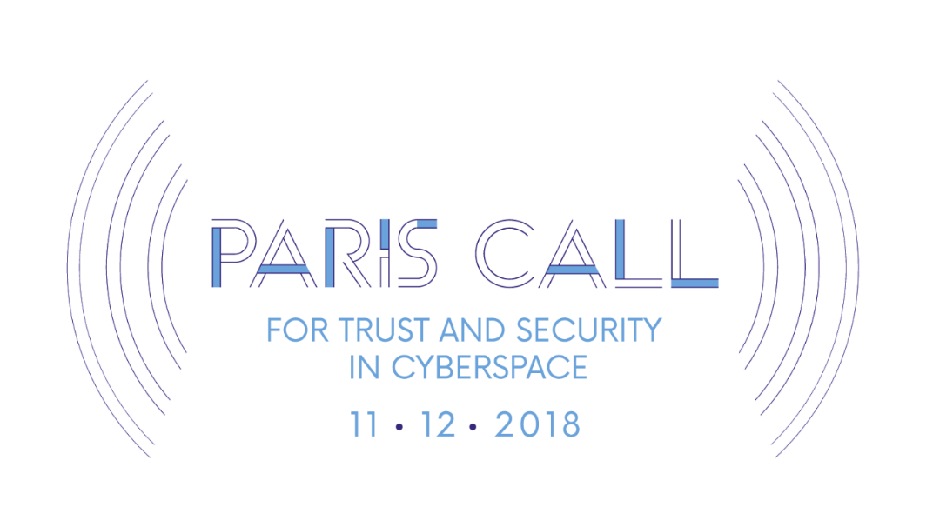
Example: Paris Call for Trust and Security in Cyberspace
Multi-stakeholder initiative endorsed by French Government during IGF 2018
Recognition of private sector’s key role in tackling cybercrime and preventing cyber incidents
Signed by EU member states, Norway, Switzerland, Japan, Mexico, Chile, Lebanon, Morocco and Republic of Korea as well as 150 companies and 60 civil society organizations
Notes:
Background
It is the first government-endorsed global effort on cybersecurity that recognizes the important role the private sector plays in protecting the important global public goods of trust and security in cyberspace
It calls for broad cooperation and capacity building but is criticized as being mostly a symbol of the need for diplomacy and cooperation in cyberspace, where it’s hard to enforce any single country’s laws
During the Paris IGF/end of 2018, President Emmanuel Macron launched a multi- stakeholder call to commit to supporting a more peaceful internet with stronger protections for users and human rights: Paris Call for Trust and Security in Cyberspace
First government-endorsed global effort on cybersecurity that recognizes the important role the private sector plays in protecting the important global public goods of trust and security in cyberspace
Builds on the reaffirmation that international law applies to cyberspace
Recognises the responsibilities of the private sector for digital products security
Calls for broad digital cooperation and capacity-building.
Criticism: Call doesn’t require governments or corporations to legally adhere to any specific principles. It’s mostly a symbol of the need for diplomacy and cooperation in cyberspace, where it’s hard to enforce any single country’s laws.
The Paris Call has strong initial support from hundreds of signatories, including leading tech companies (e.g. Microsoft, Facebook) and many governments. Yet, the USA, Russia, and China are missing from the roll. The declaration and its impact will be revisited at the Paris Peace Forum (PPF) in 2019, as well as the 2019 Internet Governance Forum (IGF) in Berlin.

Slide 17
Cyber Security Wrap Up
Cyber security issues comprise critical national security interests and cross-border cyber attacks.
It requires international collaboration for preparing and implementing counter-measures.
Although harmonisation of cyber security systems is difficult there is ample room for international cooperation on policy making.
Finding an appropriate level of cyber security regulation is a challenge: Overregulation would interfere with economic dynamism. Underregulation leaves parties open to cyber-attacks.

Slide 18
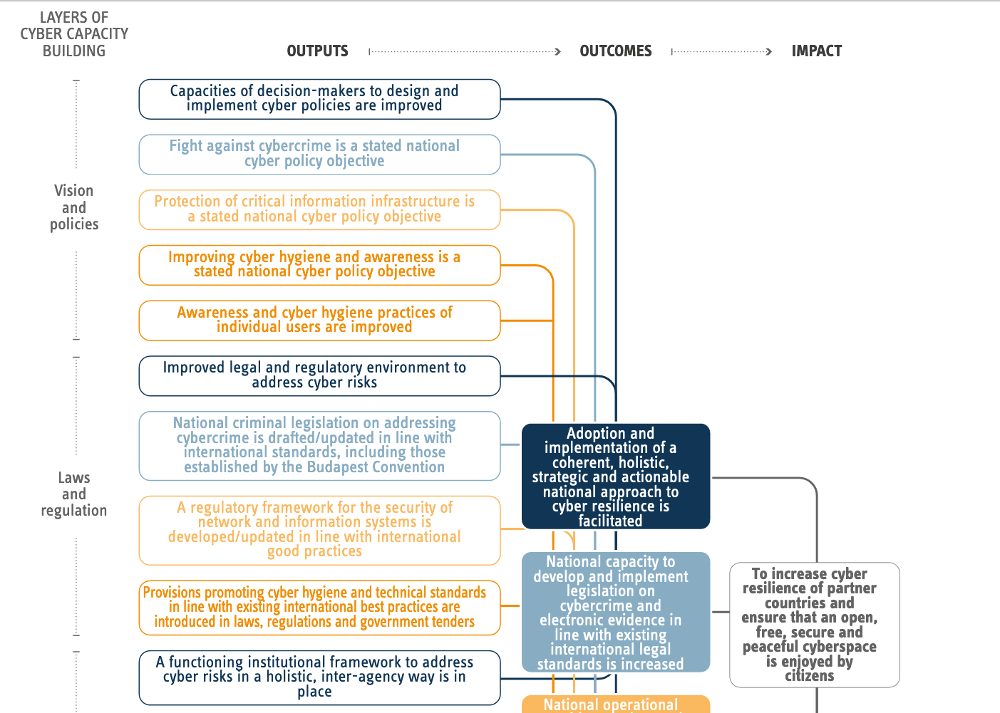
Cyber Security Example: Result Chain and Indicators for Cyber Capacity Building measures
Capacities of decision-makers to design and implement cyber policies are improved
Adoption and implementation of a coherent, holistic, strategic and actionable national approach to cyber resilience is facilitated
To increase cyber resilience of partner countries and ensure that an open, free, secure and peaceful cyberspace is enjoyed by citizens
Table taken from European Commission, Operational Guidance for the EU’s international cooperation on cyber capacity building
Notes:
Background:
Example for a result chain and indicators for measuring the results of cyber programmes.

Slide 19
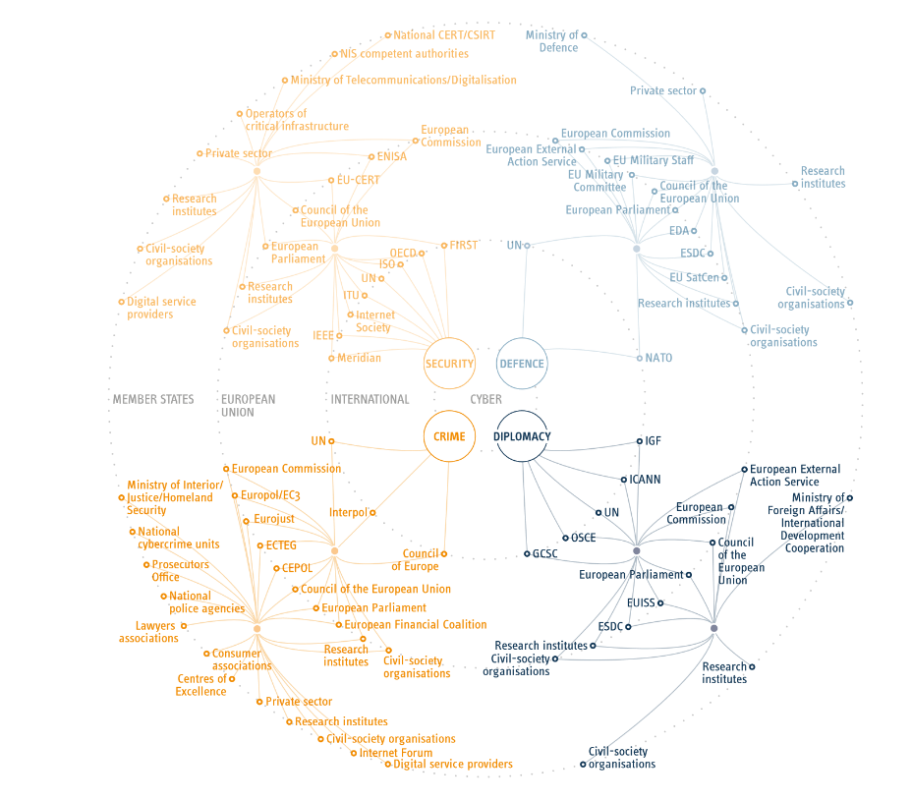
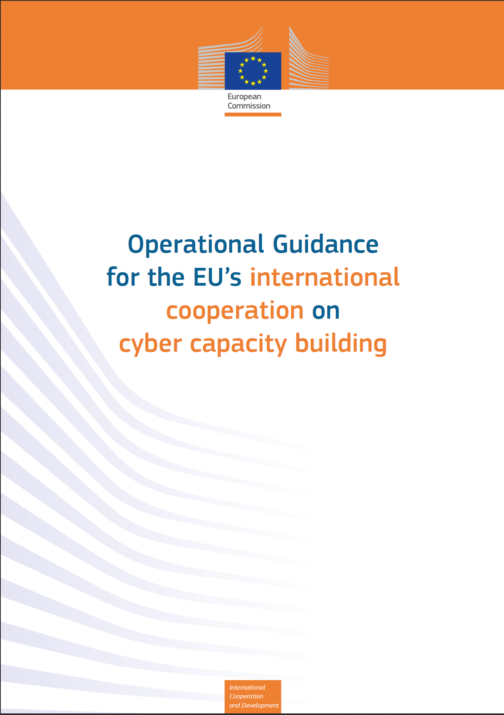
Cyber Security Key stakeholders
Notes:
Background:
Overview gives participants a glimpse into the big number of stakeholders involved in cyber security policy making. Participants have a reference for international forums and regional organizations/forum with expertise in CS issues
Resources: European Commission, Operational Guidance for the EU’s international cooperation on cyber capacity building

Slide 20
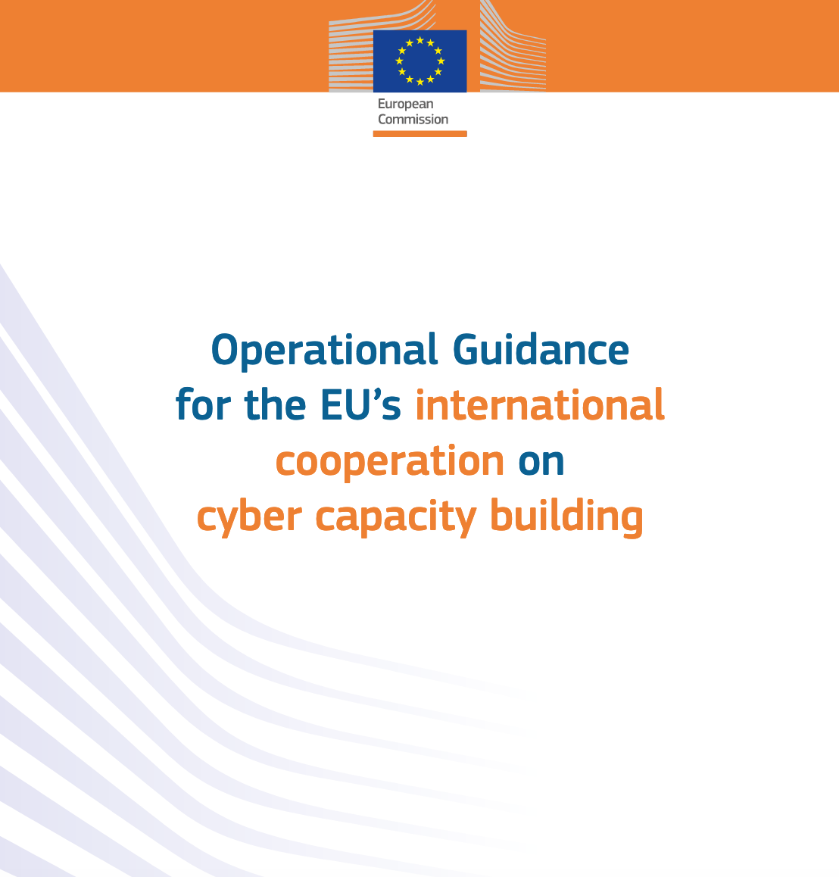
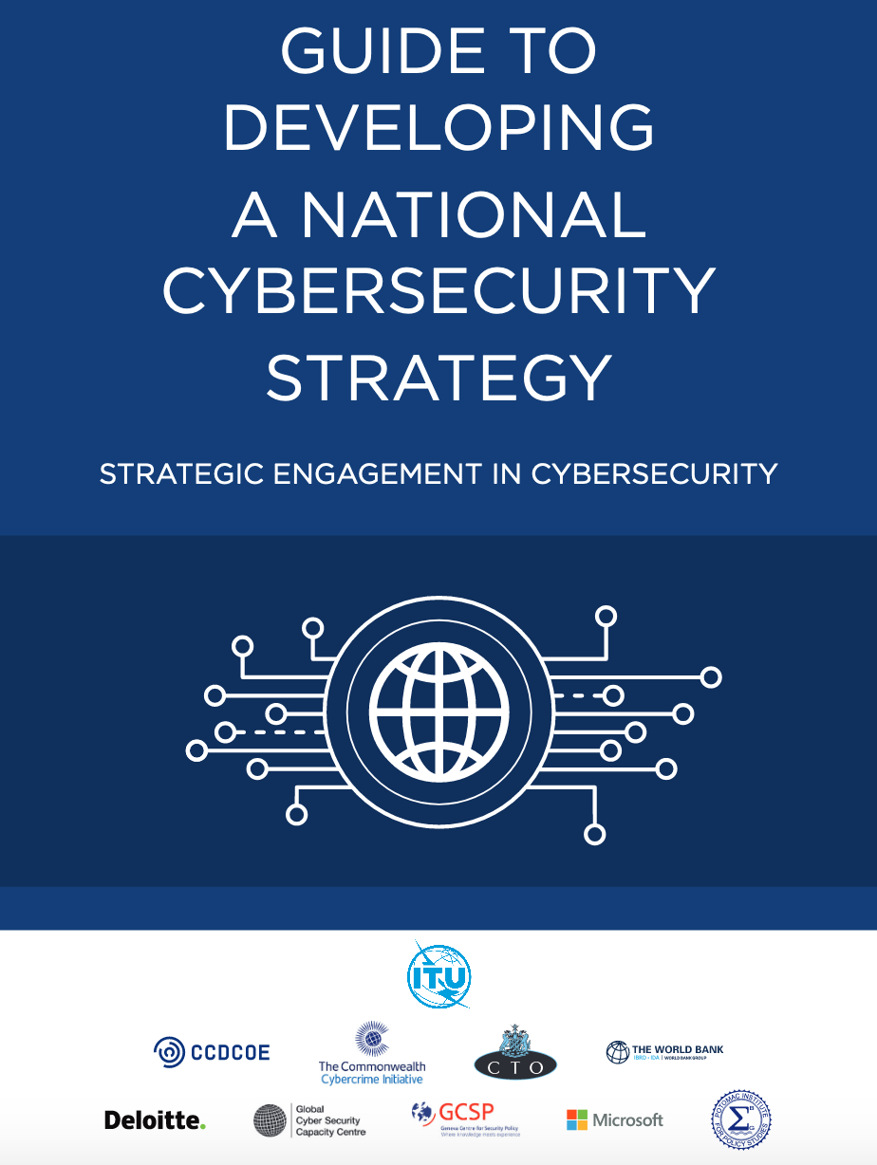
Designing Cyber Security Measures: Helpful Guidance
Notes:
Background:
Helpful guidance documents
European Commission (2018): Operational Guidance for the EU´s international cooperation on cyber capacity building
This Operational Guidance is intended to provide a comprehensive practical framework when designing and implementing theEU’s external actions against cybercrime and for promoting cybersecurity and cyber resilience. It aims to: • Provide a consolidated overview of key aspects of cyber policy; • Assist in the design of appropriate, context-specific project interventions for cyber capacity building in third countries, drawing from development best practices and lessons learned; • Propose metrics and indicators for measuring the results of cyber programmes
ITU (2018) Guide to developing a national cybersecurity strategy: The purpose of this document is to guide national leaders and policy-makers in the development of a National Cybersecurity Strategy, and in thinking strategically about cybersecurity, cyber-preparedness and resilience. This Guide aims to provide a useful, flexible and user-friendly framework to set the context of a country’s socio-economic vision and current security posture and to assist policy-makers in the development of a Strategy that takes into consideration a country’s specific situation, cultural and societal values, and that encourages the pursuit of secure, resilient, ICT-enhanced and connected societies.
https://www.itu.int/dms_pub/itu-d/opb/str/D-STR-CYB_GUIDE.01-2018-PDF-E.pdf

Slide 21
Introduction to the dimensions of digitalisation
Module 3.2.1 Deep Dive: Privacy

Slide 22
Agenda
Module 3.2.1: Deep Dive: Privacy
Introduction Privacy
Status-Quo
Frameworks
Notes:
Key message Module 3.2.1: All stakeholders of the digital ecosystem (individuals, private and public sector) need to build privacy and security issues as an integral part of their DNA.

Slide 23
Deep Dive:
Privacy

Slide 24



Introduction to Privacy Privacy protection has become the most prominent concern in the digital economy
The privacy of people’s information across sectors similarly requires robust safeguards, particularly data protection and privacy laws.
Privacy policies face to challenge to reconcile human rights values with economic efficiency
Notes:
Background:
Privacy protection has become the most prominent concern in the digital economy.
Privacy protection issues have expanded beyond personal data
Massive business-related and other data including from the internet of things (IoT) sources are starting to move across national borders. Redundant restrictions must be avoided.
The privacy of people’s information across sectors similarly requires robust safeguards, particularly data protection and privacy laws.
Given the ever-growing presence of both state and corporate surveillance the issues have been regarded as touching on human rights. Policies must be designed so as to reconcile these values with economic efficiency

Slide 25
Introduction to Privacy Different notions of privacy and a variety of different stakeholder interests create tensions
Individuals
Governments
Business
Concerns about:
Safe use of online services
Personal safety
Privacy
Concerns about:
National security and safety
Concerns about:
Compliance burdens and regulations
Knowledge protection/IPR
Notes:
Background:
Creating trust online is critically important to seize opportunities from e-commerce and the digital economy. The handling of data is a central component of this. In the current digital world, personal data are a resource that drives much commercial activity online. How these data are used can raise concerns regarding privacy and the security of information. Recent high-profile cases with political implications helped to fuel those concerns.
Data privacy and security concerns from different perspectives
Different notions of privacy and a variety of different stakeholder interests create tensions.
Individuals are concerned about their right to privacy and being able to safely and confidently use online services
Governments are concerned about national security and safety
Businesses are concerned about compliance burdens and regulations that may hamper innovation and trade.
Watchdogs, regulators and consumers are increasingly expressing concerns about the implications for security, privacy and ownership and of the use of personal data. Moreover, growing reliance on data, combined with strong network effects, can give companies that control the data considerable market power.

Slide 26
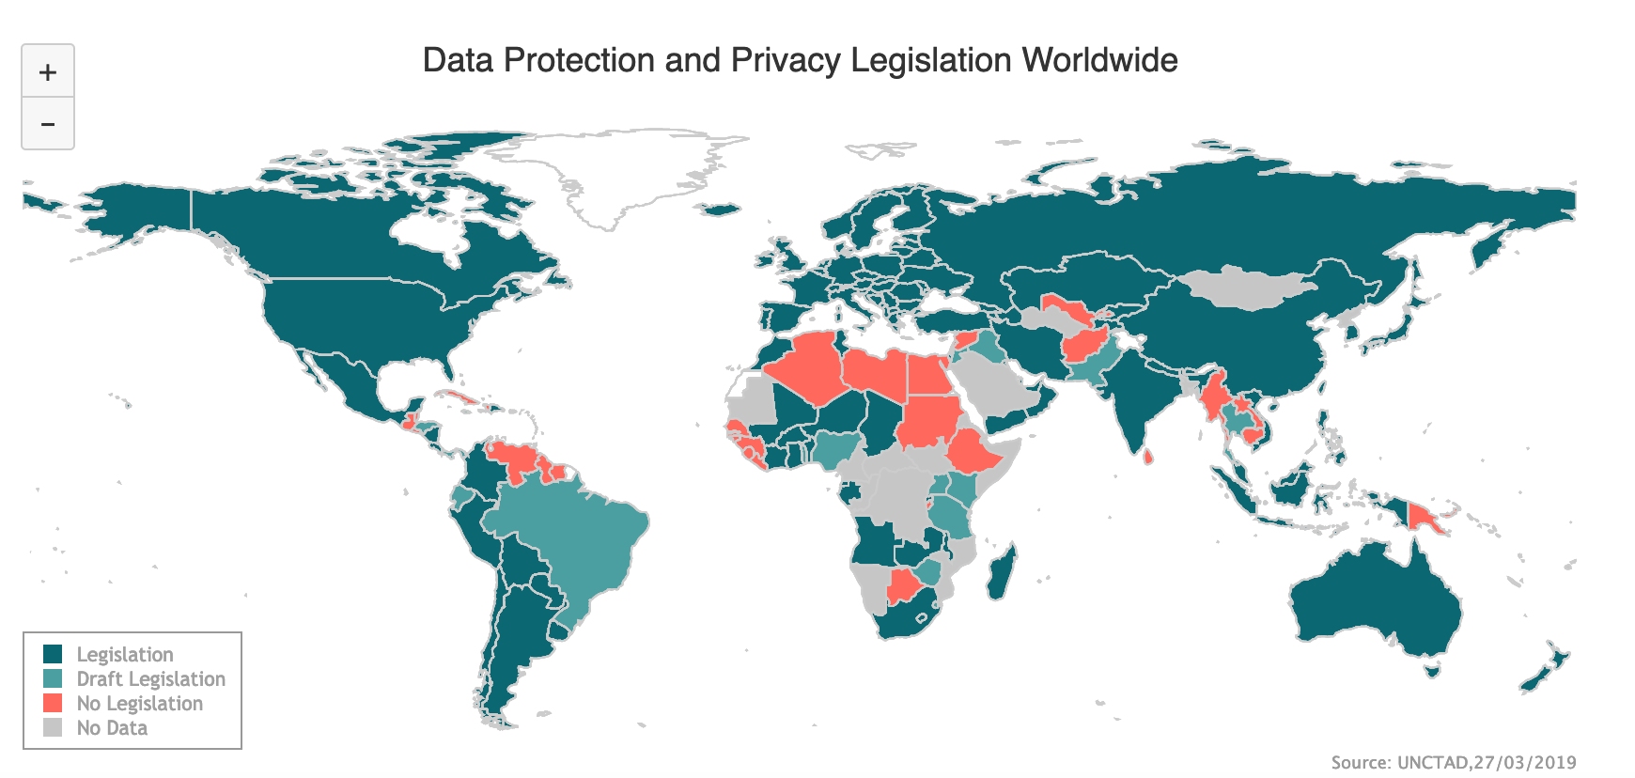
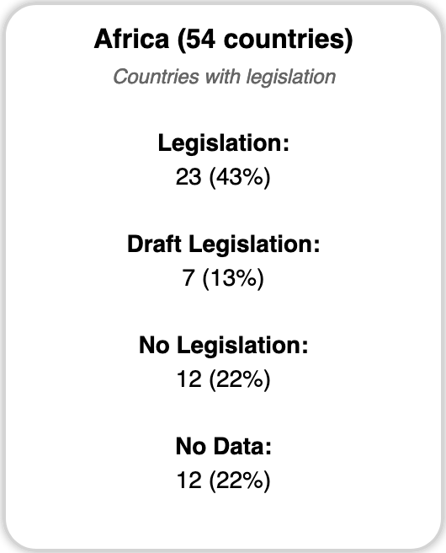
Status Quo Privacy Many countries have not yet established formal legal protection, especially developing economies
Notes:
Background:
Many countries have not yet established formal legal protection, especially developing economies
UNCTAD warns that many newly developed and developing countries have not yet established formal legal protection.
Privacy protections have been typically ensured through legal frameworks. 107 countries (of which 66 were developing or transition economies) have put in place legislation to secure the protection of data and privacy. In this area, Asia and Africa show a similar level of adoption, with less than 40 per cent of countries having a law in place.
Key attributes of such a legal framework include protection of personal data collected by organizations, such as effective and appropriate security to protect the data from theft and misuse. It is also generally accepted that organizations need to keep personal data accurate, relevant, and updated. Data subjects must be able to access and correct their personal data.
Excursus policy/Africa: The African Union Convention on Cybersecurity and Personal Data Protection, adopted in June 2014, aims to harmonise national regulations and activities in both areas and encourages cooperation and harmonisation at African level. Most African states today have no data protection regulation. Where there exists some form of data protection regulation, implementation is disparate, with no unified approach.
It is believed some of the reasons some African states do not have laws and regulation in this very important part of our lives in the 21st century is amongst other things, lack of skills and capacity to appreciate the importance of such conventions, the absence of skill and will to evaluate the cost of cyber crime to national economies, ICT not considered priority by most African governments and the fear by repressive governments, of being held accountable once committed by ratifying such conventions.

Slide 27
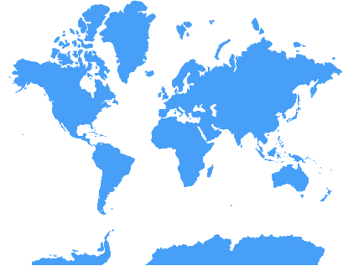
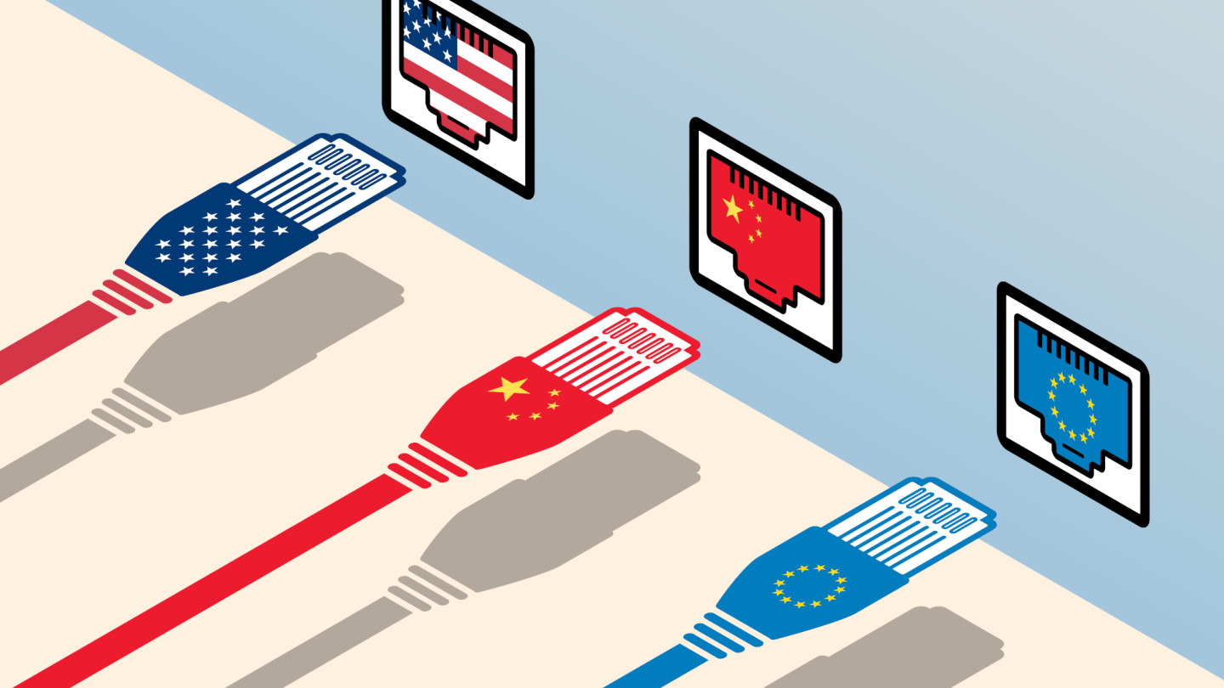
Status Quo Privacy Discussion: Danger of segmentation?
10 min
Notes:
Background:
Danger of segmentation?
The boundaries of privacy of privacy protection and the scope of data localization differ widely across countries. In particular, the three major data “realms” - the US, the EU, and China – have constructed quite different data protection regime. Without a substantive effort for harmonizing the regulatory regimes, the digital world may become segmented.
Individuals, businesses, and governments increasingly use data to create new services delivered via the internet. In so doing, they are creating a new economy built on cross-border data flows. The USA, the European Union, and China are using domestic and foreign policies to reap data-based economies of scale and scope. Essentially, they have created three distinct data realms with different approaches to data governance. As a result, they have fostered a new digital divide: between the three data behemoths and other countries that are rule takers.
Procedure:
Trainer lets participants discuss the challenges of the three data realms and the consequences for international data flows and data protection policymaking.
Timing:
10min

Slide 28

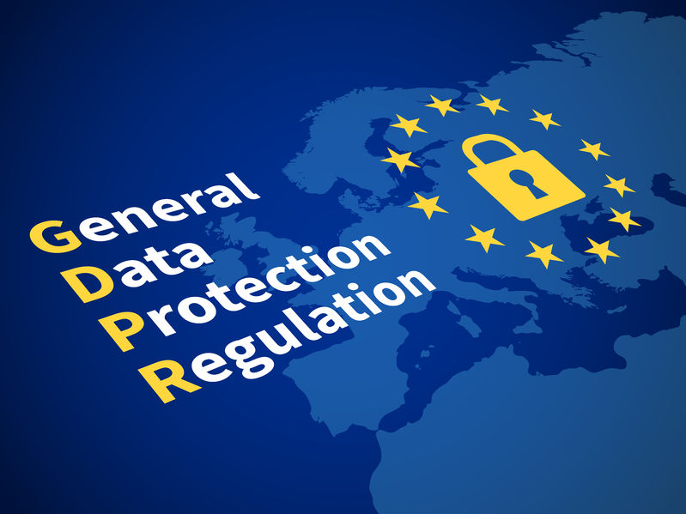

Frameworks Privacy There are widely cited frameworks to define the rules around the privacy of personal data
OECD Privacy Guidelines (2013)
APEC Privacy Framework (2015)
European General Data Protection Regulation (2018)
Notes:
Background:
There are widely cited frameworks to define the rules around the privacy of personal data
APEC
The APEC cross-border privacy rules system is a voluntary, accountability-based system that facilitates privacy-respecting data flows among APEC-economies (Asia-Pacific Economic Cooperation). So far, eight economies (the US, Mexico, Japan, Canada, Singapore, the Republic of Korea, Australia, and Chinese Taipei) have joined the system.
OECD
The OECD Privacy Guidelines became an internationally accepted set of rules for processing personal information.
Reflected in existing and emerging data-protection laws, they can serve as an excellent basis for any analytics endeavor aiming to reduce data-privacy risks. It is also a sound direction for governance of personal data collected and processed by organizations over the course of their business.
The OECD principles are closely tied with the European Union legislation and cultural expectations.
That’s why it comes as no surprise that GDPR’s spirit and much of its detail reflect the OECD privacy framework. All that makes these outlined principles are a great core for your web-analytics privacy practices.
European Genderal Data Protection Regulation
The GDPR is currently the most advanced policy for protecting private data. It clearly defines “personal data” and the rights of citizens and shows what and how the GDPR governs.
The EU imposes strong data localization requirements for personal data and establishes adequacy conditions under which cross-border data exchanges are allowed with third countries. The GDPR, which came into force in May 2018, enables better control over personal data, entitling individual protection of anonymity, pseudonymity,21 and rights to request and erase personal data (“right to be forgotten”). Another novel feature is data portability, giving individuals the right to request that their data be transferred to another controller and for data controllers to use common formats.
Criticisms of the GDPR focus on compliance costs borne by the business sector, a risk of degrading services for consumers, and stifling of innovation.15
.

Slide 29
Discussion: Inclusion or violation of privacy?
15 min
Is a specific use case valuable or dangerous? A decision often difficult to make
Access to credit: A project proposed to a national European development actor in 2017 looked to increase access to credits for people in African countries.
The innovation of the solution was the way the credit worthiness of potential customers was evaluated. The app-based solution looked to measure it by e.g.:
Reading SMS messages and checking spelling: Better spelling => better educated
Tracking the users location: How wealthy are the areas in which he/she spends time?
Analysis of the people that are called: Where do they live?
Analysis of the amount spend on calls and SMS: Can he/she afford much phone use?
The project was not supported due to privacy concerns.
Privacy is respected and people are protected from potential negative consequences. But, potentially fewer people get access to credits.
What would your decision have been? What similar examples come to your mind?
Notes:
Procedure:
Let participants tell of their ideas and examples. Pin these at a board and discuss with the audience the pros and cons of utilization or protection of the data
Show tradeoff between data use and protection
Show that there is no easy answer to the question
Timing:
15min
Source: https://www.red-gate.com/simple-talk/blogs/harsh-reality-behind-big-data-misuse/

