Slide 1
The ILO, International Labour standards, and their supervision Evelyne Pichot European Commission DG EMPL international unit 20.11.2019

Slide 2
The International Labour Organisation (ILO)
Created in 1919 - Centenary in 2019!
On a mandate of social justice
Developed the concept of decent work with 4 parts : employment + fundamental principles and rights at work + social dialogue + social/labour protection
The only tripartite international organisation
A UN agency seated in Geneva, 187 Member States
Supreme body: International Labour Conference (annual)
Core function: Setting and supervising International Labour standards
Also engaged in development cooperation and active at international level

Slide 3
1- International labour standards Types, subjects and ratification

Slide 4
International Labour Standards (ILS)
ILO Conventions (total: 190, 73 up to date)
International treaties open to ratification
Most recent: Violence and Harassment Convention, 2019, C190
When ratified, legally binding
If not ratified, a source of inspiration
ILO Protocols (total: 6)
Partially or optionally revise or amend earlier Conventions Most recent: 2014 Forced Labour Protocol, P29
ILO Recommendations (total: 206, 81 up to date)
Provide guidance
Either standalone or linked to Convention
Most recent: Violence and Harassment Recommendation, 2019, R206
Employment and Decent Work for Peace and Resilience , 2017, R205

Slide 5
ILO Fundamental Conventions
Freedom of association and collective bargaining
C87 Freedom of Association and Protection of the Right to Organise, 1948
C98 Right to Organise and Collective Bargaining, 1949
Forced Labour
C29 Forced Labour, 1930 – P29 Protocol of 2014 to C29
C105 Abolition of Forced Labour, 1957
Elimination of child labour
C138 Minimum Age, 1973
C182 Worst Forms of Child Labour, 1999
Equality of opportunity and treatment
C100 Equal Remuneration, 1951
C111 Discrimination (Employment and Occupation), 1958

Slide 6
Core labour standards, ILO Fundamental Conventions
ILO Declaration on Fundamental Principles and Rights at Work, 1998
All ILO member States,
even if they have not ratified one or more of the fundamental Conventions,
have an obligation to respect, promote and realize the fundamental rights and principles at work,
because of their membership in the Organization
ILO Centenary Declaration for the Future of Work, 2019
Safe and healthy working conditions are fundamental to decent work

Slide 7
ILO Governance Conventions
Tripartite Consultation
C144 Tripartite Consultation (International Labour Standards), 1976
Labour inspection
C81 Labour Inspection, 1947
C129 Labour Inspection (Agriculture),1969
Employment policy and promotion
C122 Employment Policy, 1964
ILO Declaration on Social Justice for a Fair Globalization, 2008
These Conventions are significant from the viewpoint of governance

Slide 8
Subjects of ILO technical standards
Wages: minimum (C131), protection (C95, C173)
Working time (incl.C14, C132)
Occupational safety and health (OSH incl.C155, C187)
Violence and harassment (C190), crisis situations (R205)
Maternity (C183), Family responsibilities (C156)
Social security (incl.C102, R202), Social policy (C117)
Vocational guidance and training (incl.C142, C140)
Employment relationship (R198), termination (C158), transition from informal to formal (R204)
Seafarers (MLC), Fishers (C188), Domestic workers (C189), other categories of workers
Migrant workers (incl.C97), Indigenous peoples (C169)

Slide 9
Ratification of ILO Conventions
Ratification:
the formal commitment by a member State to give effect, both in law and in practice, to the provisions of a Convention and to become subject to an international control on the application – Reservations are not allowed
Ratification campaigns
Fundamental Conventions: according to 1998 and 2008 Declarations, close to universal ratification; Forced Labour Protocol: objective 50, now 42
Governance Conventions: Started in 2008, Implications for technical cooperation by the ILO
Specific Conventions: Maritime Labour Convention, Domestic Workers, Violence and Harassment…
Monitored by the ILO Governing Body (GB)

Slide 10
Ratification of ILO conventions by EU MS
Fundamental conventions (core labour standards)
All EU Member states have ratified all conventions
Forced labour Protocol of 2014: 17 ratifications, on-going process
Governance/priority conventions
Employment policy C122: 26 ratifications (not LU MT)
Labour inspection: C81: All EU Member states; C129 (agriculture): 21 ratifications (not AT BG CY EL IE LT UK)
Tripartite consultation: C144: 26 ratifications (not HR LU)
Technical conventions (61 up-to-date)
Best ratified (20+ ratifications of EU Member states): C14 (weekly rest), C102 (social security), C135 (workers representatives), C142 (human resources), C148 (working environment), C159 (rehabilitation disabled), MLC (Maritime Labour Convention)
Each Member State has ratified between 11 and 55 conventions

Slide 11
Latest ratifications by EU Member States June 2017 - November 2019
Fundamental and governance conventions
Forced labour: P29 Forced labour Protocol: AT, BE, DE, DK, ES, IE, LV, MT, NL, SE
Tripartite Consultations: C144: MT
Technical conventions
Minimum wage: C131: BG; Collective bargaining: C154: CZ
Social protection: C128 C130 (benefits): BE
Health & Safety: C139 (cancer), C148 (working environment): NL; C170 (chemicals): BE, NL; C172 (hotel/rest): BE; C187 (promotional): BE, PT; C183 (Maternity): CZ
Domestic workers: C189: SE ; Indigenous peoples: C169: LU;
Maritime Labour Convention MLC: SK; Work in Fishing C188: UK

Slide 12
Latest ratifications by third countries June 2017-November 2019
Fundamental conventions (core labour standards)
Child labour:
C138 Minimum age: India, Suriname, Vanuatu;
C182 Worst Forms: Cook, Eritrea, India, Marshall, Palau, Tuvalu
Forced labour:
P29 Forced labour Protocol: Bosnia&Herzegovina, Canada, Cote d’Ivoire, Djibouti, Iceland, Israel, Jamaica, Lesotho, Madagascar, Malawi, Mozambique, Namibia, Russia, Sri Lanka, Suriname, Switzerland, Thailand, Uzbekistan, Zimbabwe
Equality/discrimination:
C111 Discrimination: Thailand
Freedom of association/collective bargaining:
C87 freedom of association: Irak;
C98 collective bargaining: Canada, Mexico, Vietnam

Slide 13
Latest ratifications by third countries June 2017-November 2019
Governance/priority conventions
Employment policy: C122: Namibia, Niger
Tripartite consultations: C144: Cameroon, Cook, Georgia, Kiribati, Mauritania, Niger, Rwanda, Samoa, Turkmenistan, Uzbekistan
Labour inspection: C81:Canada, Namibia, P81 Protocol: Mozambique
Occupational Safety and Health (OSH)
OSH: C155: Malawi, Rwanda, Singapore, P155 (Protocol): Cote d’Ivoire
Promotional framework: C187: Iceland, Malawi, Morocco, Philippines, Rwanda
Specific Risks: Chemicals C170: Cote d’Ivoire, Maternity C183: Mauritius, Niger, San Marino, Sao Tome
Specific Sectors: Agriculture C184: Malawi, Serbia; Construction C167: Russia; Mines C176: Mozambique

Slide 14
2- ILO supervisory mechanisms on the application of international labour standards

Slide 15
Regular system of supervision Submission and examination of periodic reports on the application of ratified Conventions
States: reports
Employers and Workers: comments
Committee of Experts on the Application of the Conventions and Recommendations (CEACR): Requests, examination, observations (report)
Conference Committee on the Application of Standards (CAS):
Tripartite Discussion of the CEACR report and 25 individual cases, conclusions and report

Slide 16
Reporting
Fundamental and Governance Conventions
Three-yearly reports
Other ratified conventions
Five-yearly reports
General survey
On ratified and non-ratified Conventions
One topic per year, decided by the Governing Body, , analysed by Committee of experts
Examined by CAS
2014: minimum wage, 2015: rural workers, 2016: labour migration, 2017: Health&Safety, 2018: working time, 2019: social protection floors, 2020: employment, 2021: maternity, family & discrimination

Slide 17
Committee of experts report
Direct requests directly to the government concerned
Observations: in more serious or long-standing cases of failure to fulfill obligations – all comments available on NORMLEX
Footnotes - the most serious cases: Special notes at the end of the observations asking the government to supply
"single footnote": a report earlier than would otherwise have been the case
"double footnote": full particulars to the Conference at its next session

Slide 18
"Double footnotes" in experts' report
Criteria:
seriousness of the problem
persistence of the problem
urgency of the situation
quality and scope of the government’s response
Are discussed as individual cases in CAS
2019 double footnotes (fundamental):
Forced Labour: Myanmar (C29)
Child labour: Ethiopia (C138), Irak (C182)
Discrimination: Libya (C111)
Freedom of Association: Turkey (C87)

Slide 19
Committee on the Application of Standards (CAS)
During International Labour Conference
General Report
General Survey (Social protection Floors in 2019)
Serious failures to respect reporting and other obligations
Individual cases

Slide 20
Individual cases at CAS
25 cases chosen by social partners - criteria:
Balance (geographical and among conventions)
Footnotes and other comments of the CEACR
Responses of gov., comments by employers and workers
Seriousness and persistence of shortcomings
Urgency or nature of situation
Previous CAS conclusions, special paragraph
Impact of discussion
Discussion involves government of country , social partners, other governements
Conclusions proposed by social partners
Most serious: "special paragraph" in CAS report
2015: Swaziland, Kazakhstan (C87), Mauritania (C29)
2016: Bangladesh (C87), El Salvador (C87)
Since 2017: none

Slide 21
EU Member States as individual cases in CAS 2010-2019
Croatia: C98 (2014) changes to collective bargaining
Czech Republic: C111 (2016) discrimination for political opinion and against Roma
Greece: C98 (2011,2013, 2018) collective bargaining/austerity and arbitration; C102 (2014) low level of social protection/austerity
Ireland: C98 (2016) collective bargaining of self employed
Italy: C122 (2015) employment policy to alleviate crisis impact
Poland: C29 (2017) forced labour of North Koreans
Portugal: C122 (2014) employment policy /austerity
Romania: C98 (2011) collective bargaining of civil servants
Spain: C122 (2013, 2015) employment policy/austerity, role of trade unions in policy design
UK: C87 (2016) rules on strike; C102 (2017) level of social security benefits

Slide 22
Trade FTA partners and negotiations as individual cases in CAS 2019 * with EU statements; Grey: cases 2015-2018
Americas
*Brazil: C98 (2018, 2019) on restrictions to collective bargaining and anti-union discrimination>consultations with social partners
*El Salvador: C144 (2017,2018, 2019) on lack of social dialogue and protection of social partners > tripartite agreement; C87 (2015, 2016)
*Honduras: C87 (2018, 2019) on absence of convictions for murders of trade unionists >apply tripartite agreement, protection; C81 (2015)
Uruguay: C98 (2019) on autonomy of collective bargaining>legislative changes
Ecuador: C87 (2017), C98 (2016)
Guatemala: C87 (2015, 2016, 2017)
Mexico: C87 (2015, 2016, 2018)
Paraguay: C29 (2017)

Slide 23
FTA partners and negotiations cont'd
Asia/Pacific
*Fiji: C87 (2019) on restrictions to freedom of association, violence > direct contacts mission
Indonesia: C87 (2016)
Japan: C87 (2018)
Korea: C111 (2015)
Samoa: C182 (2018)
Africa
*Zimbabwe: C87 (2019) on freedom of assembly of workers > repeal of public order
Europe/Central Asia
*Turkey: C87 (2019) on restrictions to trade unions, threats and dismissals >respect for civil liberties, due judicial process
Georgia: C100 (2018)
Moldova: C81/C129 (2018)
Ukraine: C81/C129 (2017,2018)

Slide 24
Trade GSP+/EBA countries as individual cases in CAS 2019 * with EU statements; Grey: cases 2015-2017
Americas
Bolivia: C131 (2018, 2019) on minimum wage; C138 (2015, 2018) on child labour
Asia-Pacific
*Myanmar: C29 (2019) on persistence of forced labour; C87 (2018)
*Philippines C87 (2019, 2016): murders of trade unionists >high level mission and report by September 2019
Afghanistan: C182 (2017)
Bangladesh: C87 (2015, 2016, 2017)
Cambodia: C105 (2018); C182 (2015); C87 (2016, 2017)
Africa
*Cabo Verde: C182 case of progress on worst forms of child labour
Congo D.R.: C182 (2017)
Sudan: C122 (2017)
Zambia: C138 (2017)

Slide 25
Other individual cases in CAS 2019 * with EU statements
Algeria (C87) freedom of association
*Belarus (C29) forced labour
Egypt (C87) freedom of association
*Ethiopia (C138) child labour
India (C81) labour inspection
*Iraq (C182) worst forms of child labour
*Kazakstan (C87) freedom of association
*Lao PDR C182 (2019) worst forms of child labour
*Libya (C111) discrimination
*Serbia (C81, C129) labour inspection
*Tajikistan (C111) discrimination
Yemen (C182) worst forms of child labour

Slide 26
Special procedures of supervision Specific allegations of violations against a Member State
Representation (Art. 24 ILO Constitution on violation of ratified convention)
By any employers’ or workers’ organization
Examined by ad-hoc tripartite committee established by GB
Complaint (Art. 26 ILO Constitution on violation of ratified convention)
By a ratifying State, the GB or a delegate to the Conference
May lead to Commission of Inquiry (CoI)
Examined by Governing Body
On-going case: Venezuela (CoI)
New cases 2019: Bangladesh, Chile
Closed with follow-up: Myanmar, Guatemala, Qatar
Follow-up by Governing Body and CEACR

Slide 27
Country cases at GB 2017/2019
Complaints art.26
Guatemala C 87 (murders of trade unionists)> Closure, annual review
Qatar C 29, C81 (forced labour and safety at work of migrants) >Closure, annual review
Venezuela C87, C26, C144 (freedom of association and consultation of employers)> Commission of Inquiry
Bangladesh C87, C98, C81 (freedom of association, collective bargaining and labour inspection)> receivable, examined in March 2020
Chile C87, C98, C103, C135, C151(freedom of association, collective bargaining and others) > receivable, likely to be closed in 2020 (similar complaint of 2016 closed in 2017)
Follow-up since ILC 2013 (end of sanctions)
Myanmar (forced labour and labour rights)>Decent Work Country Programme and annual review

Slide 28
Special procedure: Committee on Freedom of Association (CFA)
Complaints
On violations of freedom of association, whether or not the country has ratified Conventions 87 and 98
By any employers’ or workers’ organization
Examined by tripartite CFA, Recommendations adopted by Governing Body
Possible Direct contacts mission
Serious and urgent cases:
2017: Bangladesh, Chile, El Salvador, Guatemala, Iran, Venezuela
2018: Bangladesh, Cambodia, Guatemala, Iran, Peru, Philippines
2019: Bangladesh, Cambodia, Colombia, El Salvador, Guatemala, Iran, Philippines

Slide 29
3. EU, ILO and international labour standards -Promotion of standards -Cooperation

Slide 30
EU commitment to promote international labour standards
Part of the commitment to decent work since 2006
Promotion of ratification and effective implementation of ILO fundamental conventions and other up-to date conventions
In all policies, in particular enlargement, neighbourhood, development, human rights, trade
Internally: All EU Member States have ratified all fundamental conventions and the Labour inspection Convention; are ratifying the 2014 Forced Labour Protocol; have ratified many technical conventions

Slide 31
EU contribution to adoption and review of ILO standards: examples
Protocol to the Forced labour Convention (2014): part of core labour standards
EU contribution to adoption of P29 and R203 at ILC 2014
Council Decisions to authorize and call for ratification of Protocol
Violence and harassment in the world of work (2019)
EU contribution to adoption of Violence and Harassment Convention 190 and Recommendation R205 at ILC 2019
Link to women at work, discrimination, LGBTI
Context of metoo debate
Link to Istanbul Convention (CoE)
Intention to propose Council Decision to authorize and call for ratification
Standard review Mechanism (SRM) (since 2016)
Active contribution to SRM Tripartite Working Group and GB follow up

Slide 32
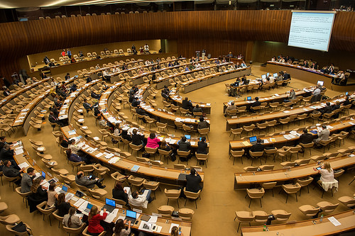
Adoption of forced Labour Protocol by ILC in June 2014 with active EU support

Slide 33
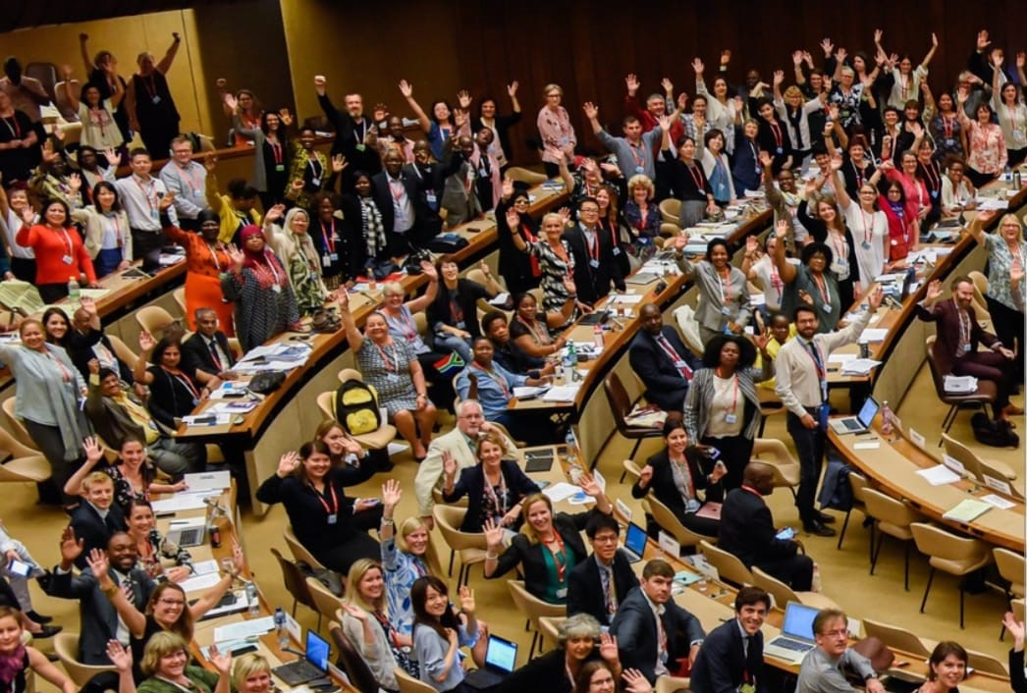
Adoption of Violence and Harasment Convention by ILC in June 2019 with active EU support

Slide 34
Promotion of international labour standards in the EU
ILO standards as references for EU law (and vice-versa)
Fundamental ILO conventions as sources of general principles of EU law and fundamental rights
Promotion of ratification of specific conventions:
Fundamental conventions in enlargement process
Council Decisions: C170 (chemicals), C185 (Seafarers Identity Documents), MLC (Maritime Labour Convention), C188 (Work in Fishing), C189 (Domestic workers), P29 (Forced labour Protocol)
EU Pillar of Social Rights: Social security conventions, C122 (employment), C144 (tripartite consultation), C131 (minimum wage), C135 (workers' representatives), C154 (collective bargaining)
Policy documents: Anti-trafficking and employment strategies C189 (Domestic workers), Ocean governance C188 (Work in Fishing) and MLC

Slide 35
EU contribution to implementation of ILO standards: examples of maritime and fishing
Maritime Labour Convention MLC, 2006
26 EU Member States have ratified
EU social partners concluded an agreement on the implementation of the MLC in the EU
This agreement is implemented through EU law: Directive 2009/38/EU
Enforcement is complemented by Flag State Directive 2013/54/EU and Port State Control Directive 2013/38/EU
2014 amendments to the MLC became similarly Directive (EU) 2018/131, ongoing for 2016 amendments
Work in Fishing Convention C188, 2007
4 EU MS (EE FR LT UK) ratified, 3rd triggered entry into force
EU social partners concluded an agreement on the implementation of C188 in the EU
This agreement is implemented through EU law: Directive (EU) 2017/159

Slide 36
EU contribution to supervision of ILO standards
Importance of EU statements on country cases for the ILO standard supervisory system
Content
Call for respect of human rights (core labour standards)
Call for dialogue with social partners
Support to progress
Call for cooperation with the ILO
Basis
Human rights strategy
Trade instruments
Partnership and association agreements
Online on EU Delegation UN Geneva webpage

Slide 37
EU contribution to adoption of ILO policies: recent examples
Fundamental Principles and rights at Work
Decent Work in Global Supply chains
Labour provisions in trade agreements
Revised Declaration on multinational enterprises and social policy (MNE Declaration)
Labour migration
Development cooperation in support to SDGs + strategy to be defined at GB March 2020
Future of work (see Centenary Declaration)
Upcoming ILC 2020: inequalities, social protection, skills

Slide 38
The EU and the ILO work together
Framework for EU-ILO cooperation
Exchange of letters renewed in 2001
2004 Partnership on development cooperation
Annual high level meetings
Political and working relations
Shared objectives/ values
Social justice
Decent work
Labour standards
Social dialogue

Slide 39
On-going Cooperation with the ILO
Orientations set at High level meeting – last in October 2018
Focus 2019:
Partnership and cooperation for sustainable development
Future of work and EU pillar of social rights
International Labour Standards- Trade and labour
Women's rights and gender equality in the world of work
ILO-EU partnership for the ILO Centenary
Exploring specific areas of cooperation:
Decent Work in global supply chains
Migration, refugees and decent work in fragile contexts
Mega events and labour standards
Maritime and fishing
Joint research

Slide 40
EU-ILO Cooperation - projects
Global: studies, women, indigenous peoples, fair recruitment, child labour and forced labour, Vision Zero Fund/OSH
Third countries: employment, migration, youth and training, supply chains
Third countries – labour standards: comprehensive support (Western Balkans, Bangladesh, Myanmar), ratification application and reporting (Vietnam, Thailand, GSP+, Post GSP+ countries), capacity building and social dialogue (Turkey, Cariforum), Labour inspection (Ukraine, Thailand), SMEs (Pakistan), fishing (Thailand, ASEAN)
EU: social dialogue, undeclared work, labour inspection
The EU is the first donor to the ILO

Slide 41
ILO-EU work together on policy: examples
Joint research
Examples: Trade policies, OSH in global supply chains
Decent work in global fora
Cooperation in the G20 and the 2030 Agenda
Labour standards
Bangladesh sustainability compact, Myanmar labour rights initiative
Cooperation on labour rights in Thailand, Uzbekistan
Support to GSP+ countries
Future of work contribution to each other initiatives
Social dialogue
Joint project in EU and enlargement countries

Slide 42
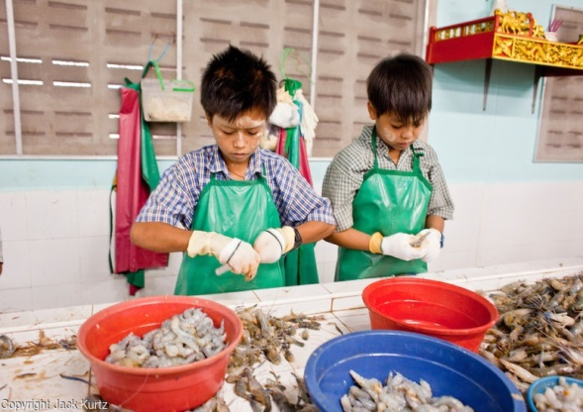
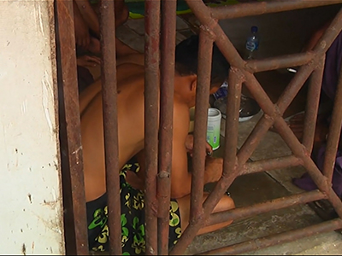
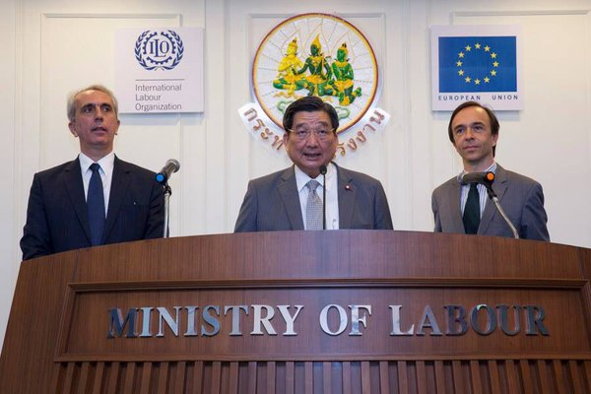
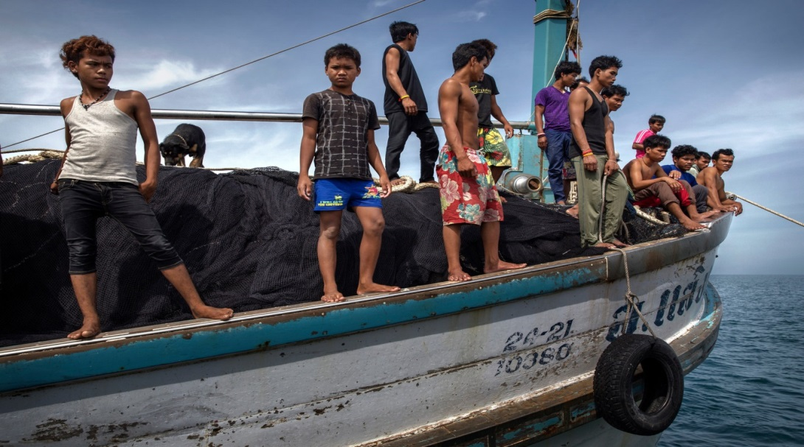
5 years’ project to combat unacceptable forms of work in Thai fishing and seafood industry

Slide 43
4. ILO Centenary ILO Centenary Declaration for the future of work, 2019

Slide 44
ILO Centenary International Labour Conference (ILC) 2019
100 years of the International Labour Organisation (ILO)
Geneva, June 2019, 108th session of the ILC, ILO's supreme body, marked by the Centenary and the future of work
Over 6000 participants, many high-level, including 31 Heads of State and Government, 113 Ministers, as well as heads of international organisations (UN, WTO, WB, IMF, OECD, OHCHR, UNHCR…), companies and social partners
Main outcomes
ILO Centenary Declaration for the future of work
Convention on Violence and harassment in the world of work
Application of International Labour Standards on social protection floors and in 24 countries

Slide 45
ILO Centenary Declaration for the future of work – Main orientations
The Declaration sets orientations for a human-centered approach to the future of work including on :
Just transition to a sustainable future of work
Skills, effective lifelong learning and support to transitions throughout working lives
Transformative agenda to achieve gender equality at work
Safe and healthy working conditions to become a fundamental principle and right at work
Universal access to social protection, adequate minimum wage, limits on working time and other labour protection to all workers
Privacy and personal data protection and responses to digital change and platform work.

Slide 46
ILO Centenary Declaration for the future of work – Actions
The Declaration gives particular importance, in pursuit of a human-centred approach to the future of work, to:
The ILO setting, promotion, review and supervision of International Labour Standards, the ratification and implementation of fundamental conventions by Members
The role of social dialogue, including cross-border, and related capacity buiding
ILO’s role in the multilateral system and policy coherence between social, trade, financial, economic and environmental policies
The Declaration also calls for the democratisation of ILO governance, which refers to the distribution of seats at the Governing Body

Slide 47
ILO Centenary Declaration for the future of work – Specific points
The Declaration includes points relating to :
Young people, older workers, persons with disabilities
Violence and harassment in the world of work
Technological progress, productivity growth, innovation
Work arrangements, employment relationship
International integration, supply chains and cross-border cooperation
Private and public sectors, informality, business practices
Labour inspection and administration
ILO role on labour migration
ILO statistics, research, knowledge and expertise
ILO development cooperation

Slide 48
EU team for the adoption of the ILO Centenary Declaration by ILC in June 2019

Slide 49
More information
ILO Normlex
http://www.ilo.org/dyn/normlex/en/
ILO Brussels Office
http://www.ilo.org/brussels
DG EMPL http://ec.europa.eu/social
EMPL external relations page (see partners)
http://ec.europa.eu/social/main.jsp?catId=87

